Slide 1
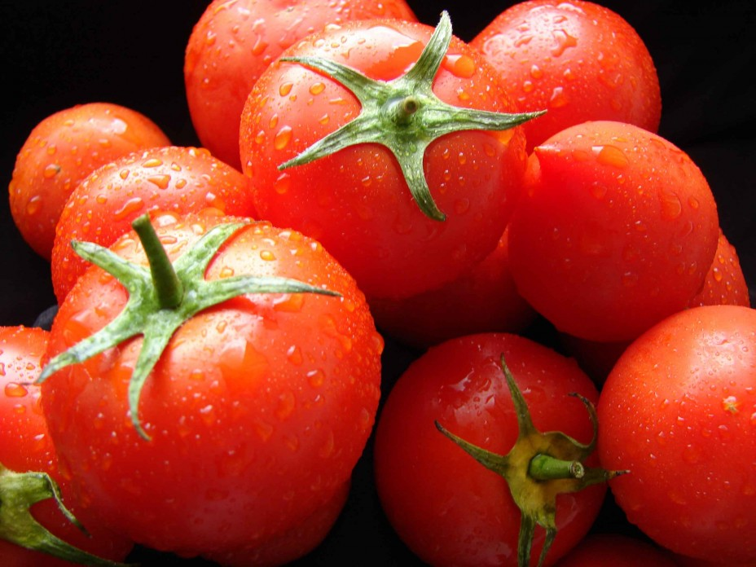
TOMATO

Slide 2
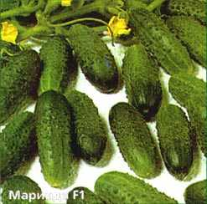
CUCUMBER

Slide 3
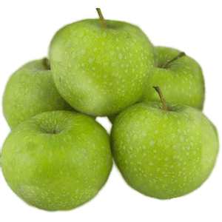
APPLE

Slide 4
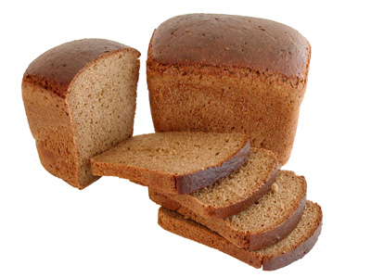
BREAD

Slide 5
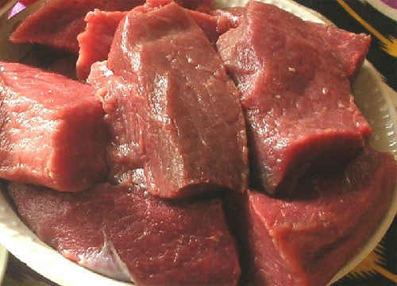
MEAT

Slide 6
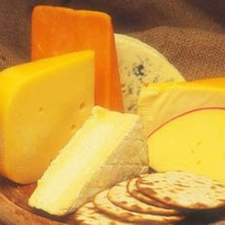
CHEESE

Slide 7
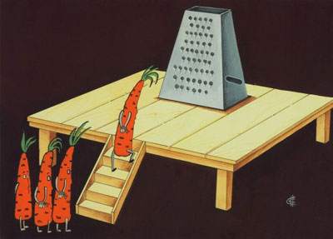
CARROT

Slide 8
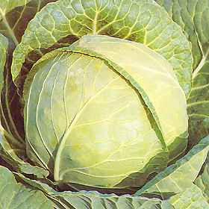
CABBAGE

Slide 9
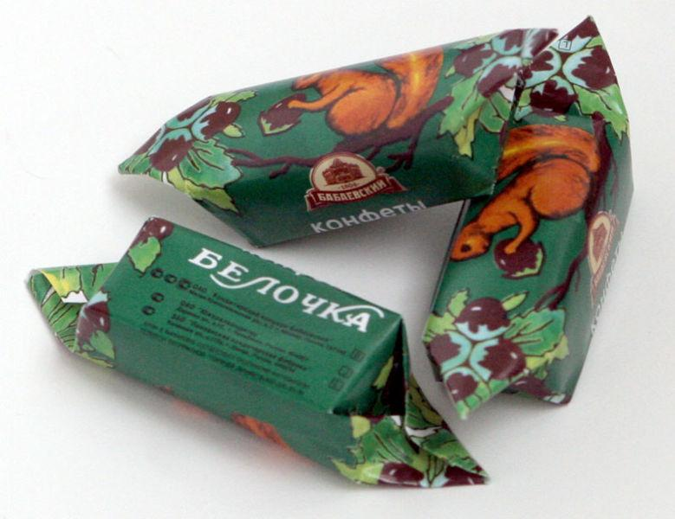
SWEETS

Slide 10
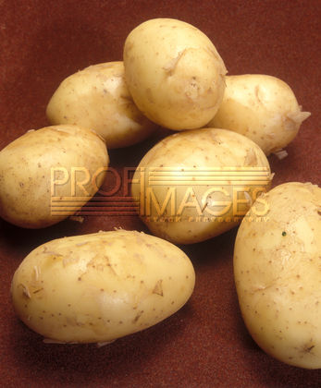
POTATO

Slide 11

COFFEE

Slide 12

TEA

Slide 13
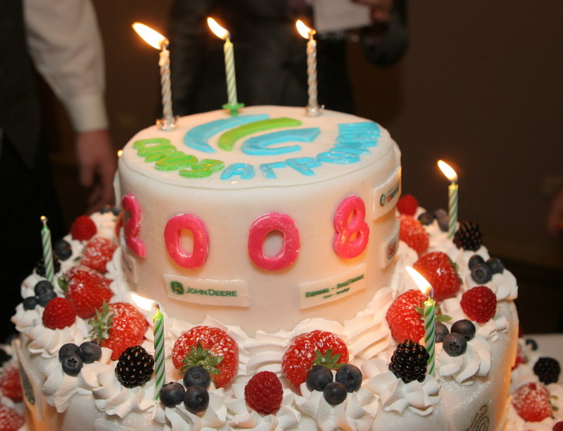
CAKE

Slide 14

MILK

Slide 15
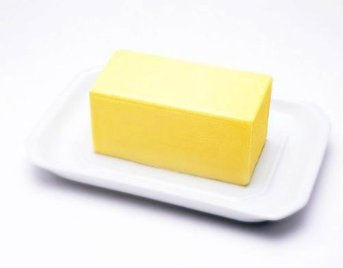
BUTTER

Slide 16
НАПИШИ СЛОВА В ДВЕ КОЛОНКИ
MANY MUCH
POTATO TEA
MEAT CUCUMBER
COFFEE SWEETS
CAKE CHEESE
BREAD APPLE
MILK CARROT
TOMATO BUTTER
CABBAGE

Slide 17

YOU ARE VERY CLEVER CHILDREN!

