Slide 1
What are the most important things in people’s life?

Slide 2
There are things which can change our life but we start and end with family.

Slide 3
Give your points of view on the title of our lesson.

Slide 4
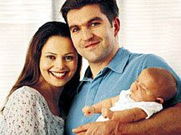
My family.

Slide 5
- Members of the family, - relatives, - their hobbies, - home responsibilities, - pets.

Slide 6
How to work: 1. Pronounce the words correctly. 2. Explain how to use s-endings in different functions: - plurals (a son-sons); - possessive case (my son’s friend); - Present Simple (in the 3rd perso-nal singular) (He loves his family.)

Slide 7
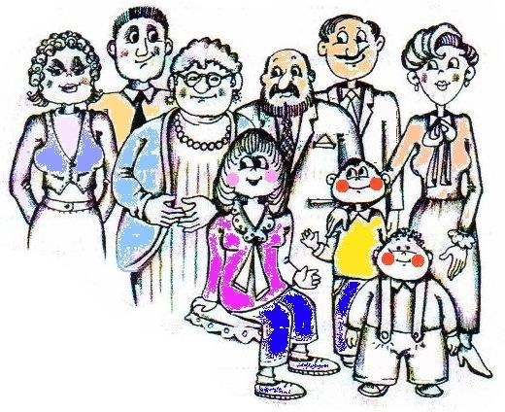
Task 1: pronounce the words correctly:
grandfather
father
uncle
mother
aunt
me
grandmother
cousin
brother

Slide 8
mother niece grandfather cousin aunt grandmother father brother uncle

Slide 9
Which other close relatives can you name?

Slide 10
(Family) mother father grandfather grandmother brother sister son daughter uncle aunt cousin niece nephew wife husband

Slide 11
Which ones are females?

Slide 12
Females: grandmother, mother, daughter, sister, aunt, cousin, niece, wife.

Slide 13
Which ones are males?

Slide 14
Males: grandfather, father, son, brother, uncle, cousin, nephew, husband.

Slide 15
Find all hidden words.
j o k p l m o t h e r k
h g r f a t h e r o k u i
j t h f s v j o s o n u j
k s r d a u g h t e r y j
k b r o t h e r u h f b p
h g y s is t e r j m n g
g t y h a u n t g I m j
h u n c l e n y h k j j
s c o u s in h n k p d
c f g r a n d m o t h e r
a g r a n d f a t h e r h

Slide 16
Write the words from the letters.
oterhm rhebot
erftah tsries
ncelu ifwe
sbahudn tanu
uscnoi ieecn
wnehpe

Slide 17
How to work: 1. Pronounce the words correctly. 2. Explain how to use s-endings in different functions: - plurals (a son-sons); - possessive case (my son’s friend); - Present Simple (in the 3rd personal singular) (He loves his family.)

Slide 18
Let’s watch the film.

Slide 19
One by one ask questions to each other and give full answers.

Slide 20
What title can be given to the text?
Anna’s family.

Slide 21
What is the film about?
The film is about typical English family.

Slide 22
What is the name of the main hero of the film?
The name of the main hero of the film is Anna.

Slide 23
Where does she live?
She lives in Oxford.

Slide 24
How old is she?
She is eighteen.

Slide 25
How many members are there in her family?
There are five members in her family.

Slide 26
What’s her father’s name?
Her father’s name is Patrick.

Slide 27
How old is he?
He is 46.

Slide 28
What’s his hobby?
Cooking is his hobby.

Slide 29
What’s her mother’s name?
Her mother’s name is Liz.

Slide 30
How old is she?
She is 39.

Slide 31
What’s her hobby?
Writing is her hobby.

Slide 32
What’s her sister’s name?
Her name is Jessica.

Slide 33
How old is she?
She is 16.

Slide 34
What’s her hobby?
Her hobby is playing
the guitar.

Slide 35
What’s her brother’s name?
His name is Tom.

Slide 36
How old is he?
He is 9.

Slide 37
What does he like doing?
He likes to play computer games.

Slide 38
Have they got any pets?
Yes, they’ve got a dog.

Slide 39
What’s its name?
Its name is Archie.

Slide 40
How old is it?
It’s five months only.

Slide 41
Does Anna love her dog ?
Yes, she loves her dog very much.

Slide 42
Are they friends?
Yes, they are friends.

Slide 43
What kind of family is that?
It’s a typical English family.

Slide 44
Explain how to use s-endings in different functions: - Plurals (a son-sons); - Possessive Case (my son’s friend/ my sons’ friend(s)); - Present Simple (in the 3rd Personal Singular) (I love my family. / He loves his family.)

Slide 45
What do you know about these words:
sister’s hobbies lives members brothers’ likes

Slide 46
Individual tasks “S-endings”

Slide 47
1.Make a topic about Anna’s family (in Present Simple: in the third personal singular).

Slide 48
2. Write the nouns in plurals Find the odd words.
Family, uncle, child, wife, old, brother, nephew, man, me, female, elder, boy, woman.

Slide 49
3.Choose the correct word and explain how to use Possessive Case.
1. My (brother’s / brothers’) name is Mark.
2. His (cousin’s / cousins’) names are Jill and Jim.
3. Our (childrens’ / children’s) names are Kate and Mary.
4. These are our (babys’ / babies’) dresses.
5. I like riding (my elder’s brother/elder brother’s) bike.

Slide 50
4. Choose the correct word and explain how to use Pr. Simple (in the third personal singular).
1. Ann’s parents (work / works) as doctors.
2.(Do/Does) Lucy's sister live in Oxford?
3.His brother’s friends (doesn’t/don’t) like playing computer games.
4.How often do you visit your grandpa-rents? I often (visit / visits) them.
5. Helen usually (comes/come) home late.

Slide 51
How to work: 1. Pronounce the words correctly. 2. Use “older - (the) oldest” or “elder-(the) eldest” to compare ones’ relatives’ age. 3. Explain how to use s-endings in different functions: - plurals (a son-sons); - possessive case (my son’s friend); - Present Simple (in the 3rd personal singular) (He loves his family.)

Slide 52
- members of the family, - relatives, - hobbies, - pets.

Slide 53
We have revised:
1. The words about family.
2. Adjectives “old-older-(the oldest)”, “old-elder-(the) eldest”.
3. Pr. Simple (in the third personal singular).
3. Possessive Case.

Slide 54
There are things which can change our life but we start and end with family.

Slide 55
Your home task for Friday: 1. Make a topic about your family. 2. Make a topic about Anna’s family according to the questions you have. 3. Read and translate the text about Anna’s family.

