Slide 1
h [h] hello, house, hair, have, has, he sh [ʃ] ship, fish, shelf, she th [θ] thanks, three, mouth

Slide 2
white [ waɪt]

Slide 3
I have got dark hair.
I have got black eyes.
I have got big ears.

Slide 4
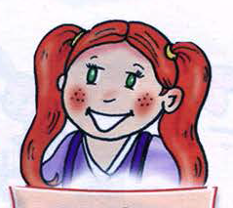
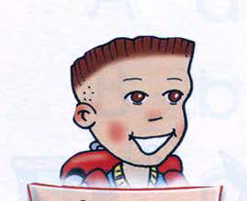
He has got...
She has got...

Slide 5
Larry:
He has got dark ________.
He has got brown _______.
He has got a big _______.
Lulu:
She has got red _______.
She has got green ______.
She has got small_______.

Slide 6
Larry:
He has got dark hair.
He has got brown eyes.
He has got a big mouth.
Lulu:
She has got red hair.
She has got green eyes.
She has got small ears.

