Slide 1
Who is the smartest in English?
5A V. 5B

Slide 2
Round 1
Test

Slide 3
Round 2

Slide 4
Round 3

Slide 5
Match Opposites
ugly Downstairs
Big backward
young light
Slow Expensive
forward beautiful
Negative Go
Upstairs Fast
strong Sad
Cheap Old
long light
Dark Small

Slide 6
Guess the riddles
Round 4

Slide 7
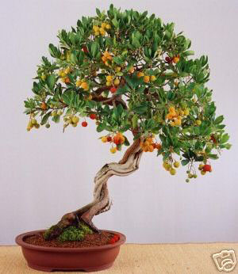
Guess the riddles!
Higher than a house,
Higher than a tree
Oh whatever can that be?

Slide 8
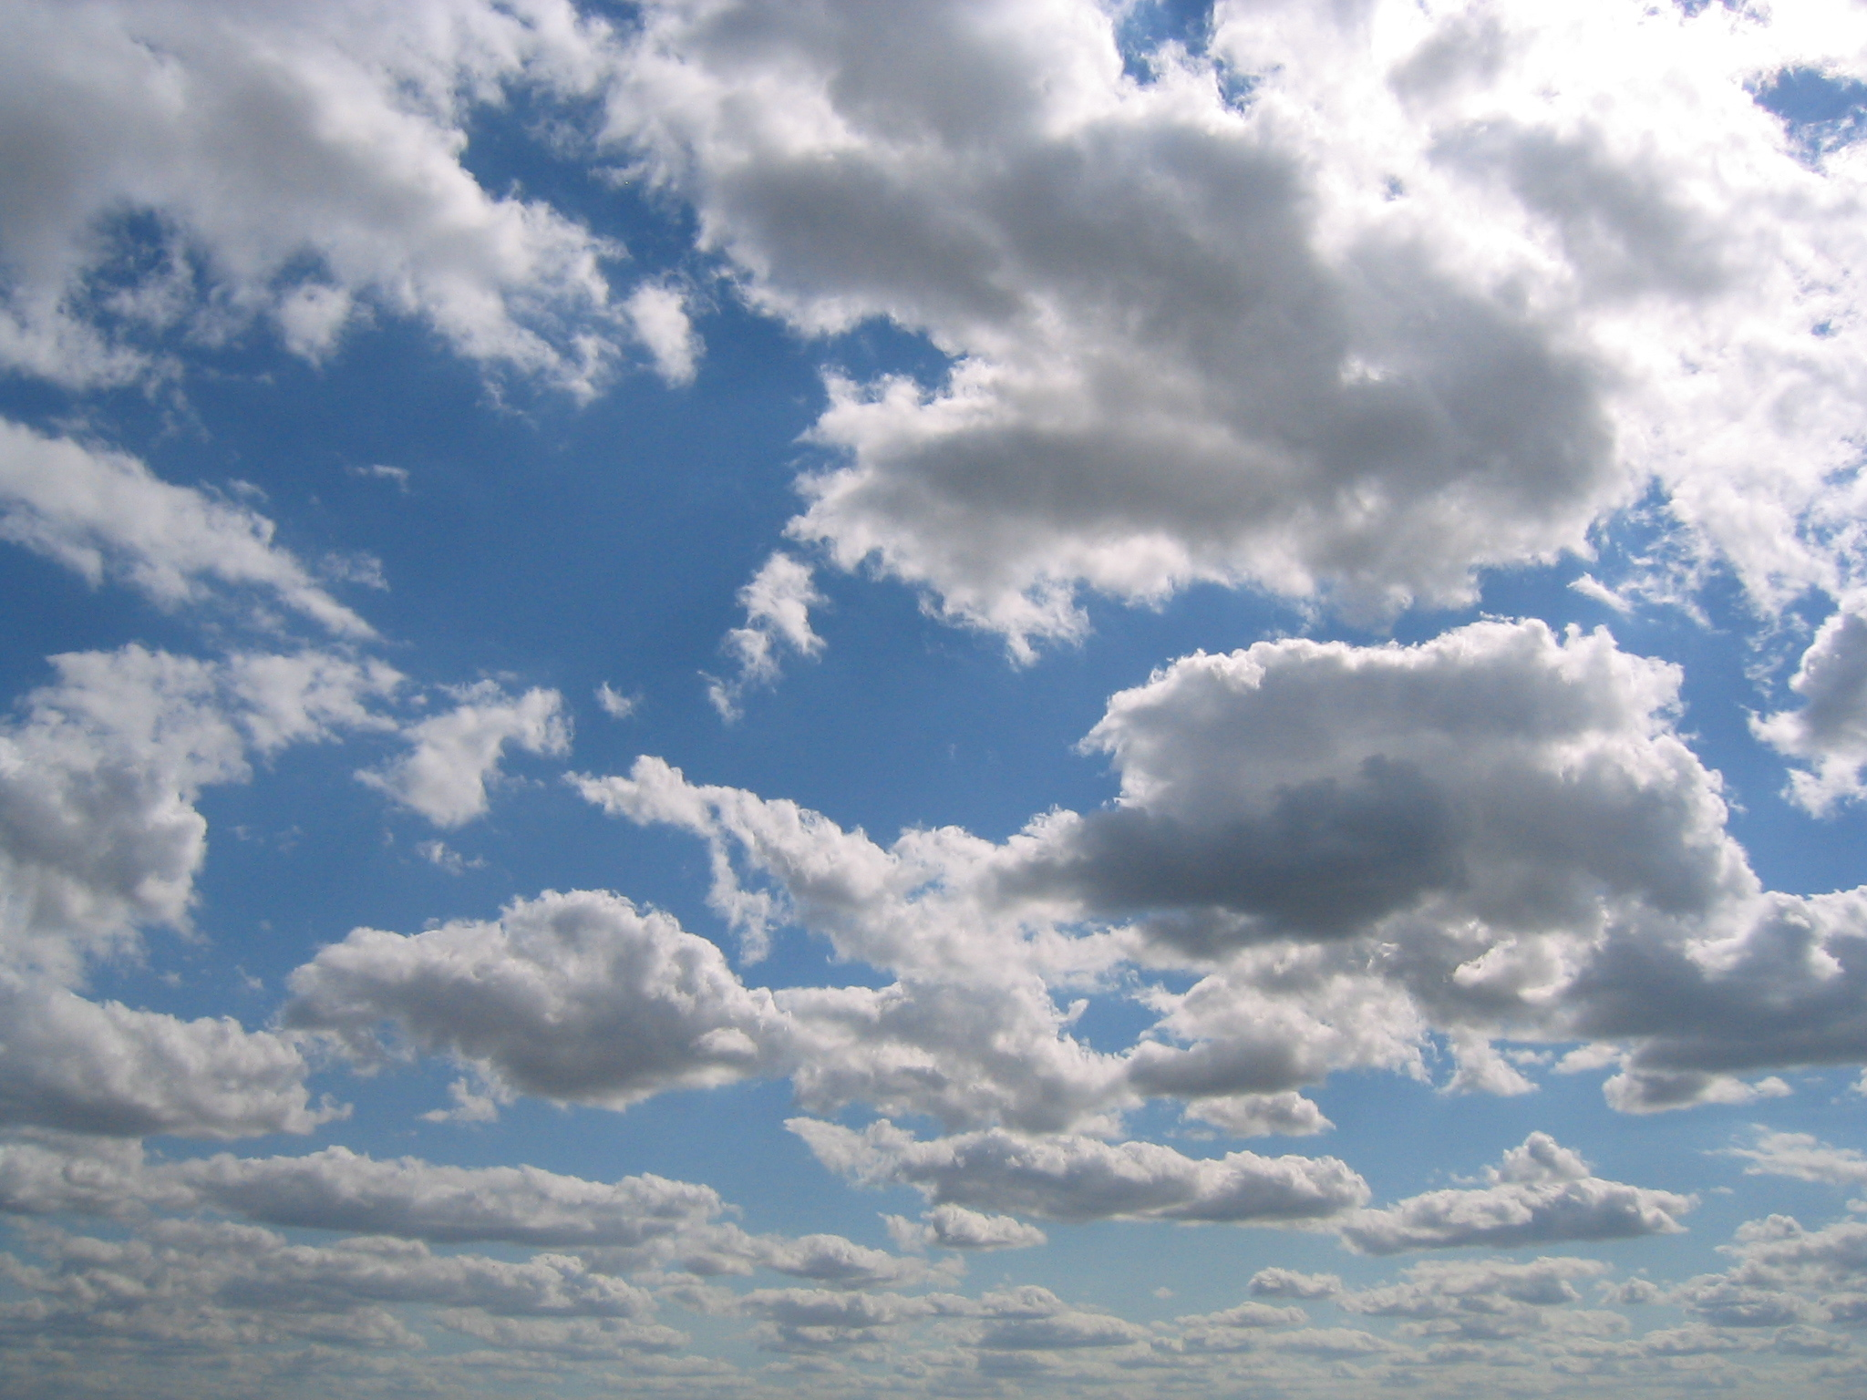

Slide 9
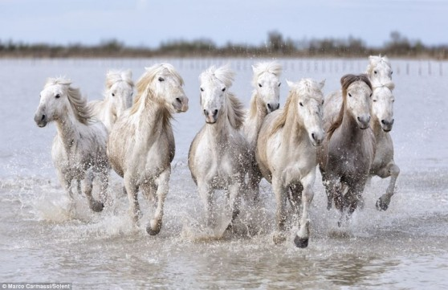
Thirty white horses
Upon a red hill,
Now they stamp,
Now they champ,
Now they stand still

Slide 10
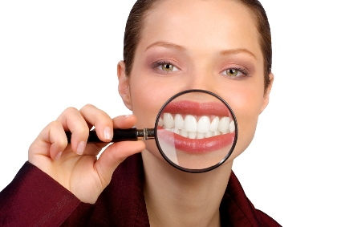

Slide 11

Guess the riddle
What has a face and two hands but no arms or legs?

Slide 12
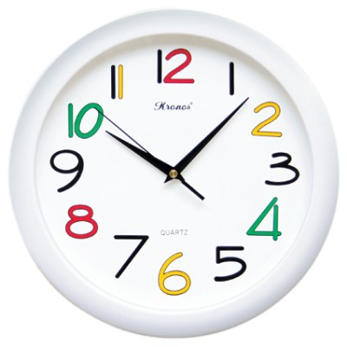

Slide 13
What five-letter word becomes shorter when you add two letters to it?

Slide 14
short

Slide 15
Tell the time
Round 5

Slide 16
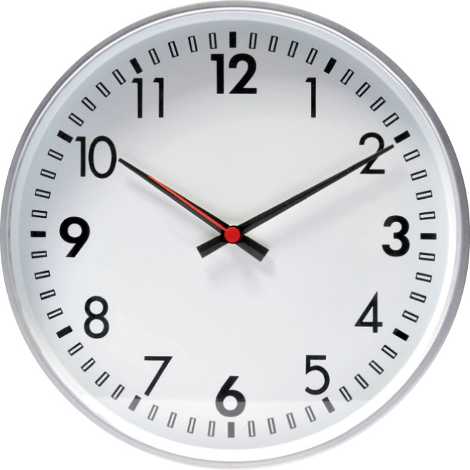

Slide 17
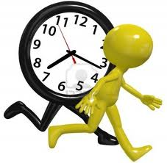

Slide 18


Slide 19
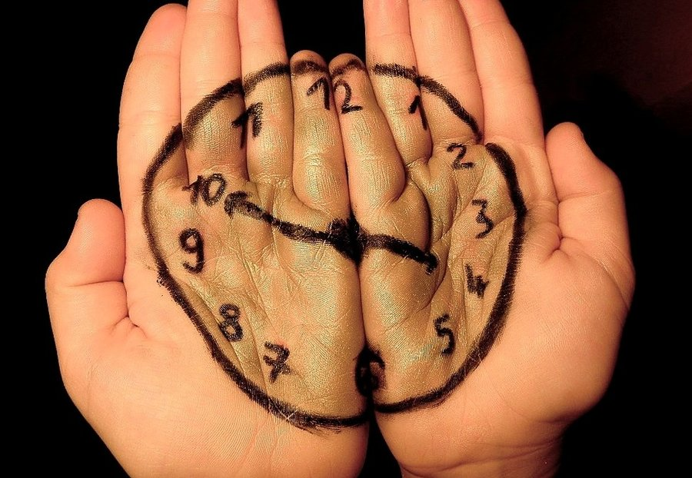

Slide 20
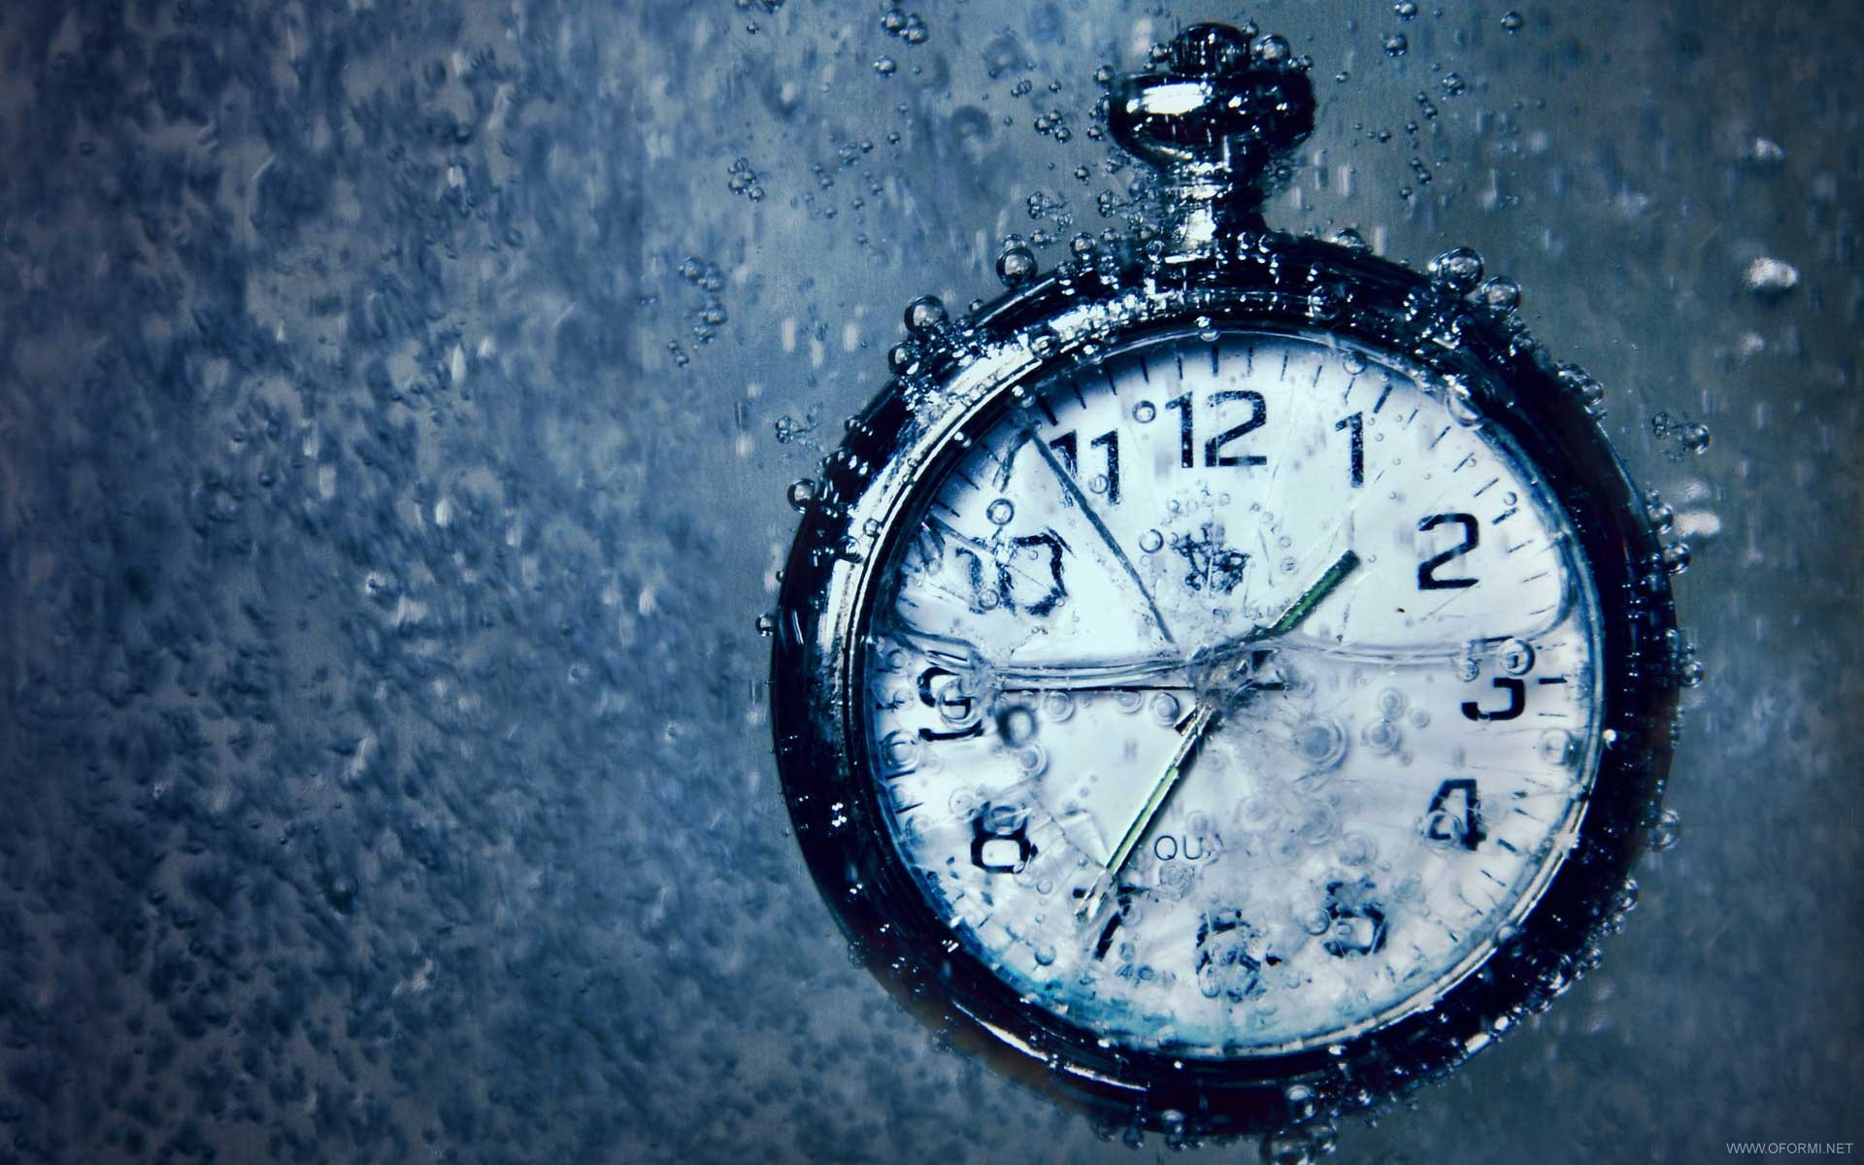

Slide 21
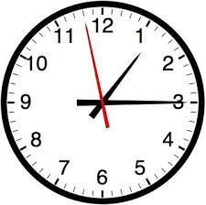
What`s the time?

Slide 22
Comprehension activity
Listen and answer the questions!

Slide 23
Make up a short story using the following key-words
Lost in Cyberspace
Jungle
Mountain
Cave
Desert

Slide 24
Thank you!

