Slide 1
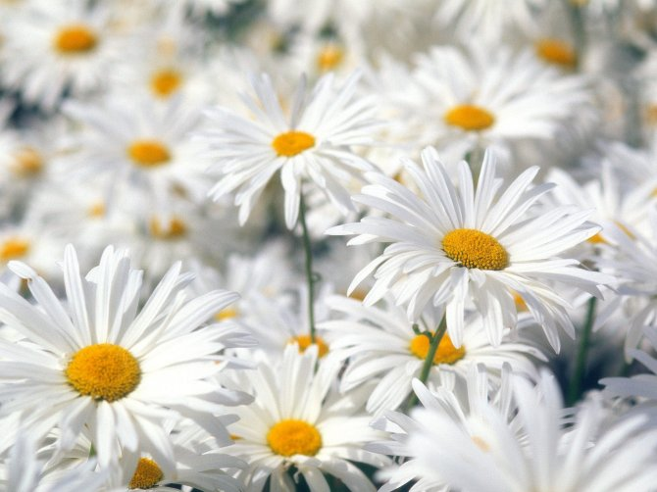
Plural Form of the Nouns
Множественное число имен существительных

Slide 2
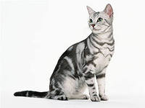
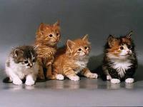
-S
Singular
Plural
Flag
Cat
Flags
Cats

Slide 3
-s, -ss, -sh, -ch, -x, -o - -es
Singular
Plural
Bus
Class
Dish
Watch
Fox
Potato
Buses
Classes
Dishes
Watches
Foxes
Potatoes

Slide 4
BUT
PHOTOS
PIANOS
RHINOS

Slide 5
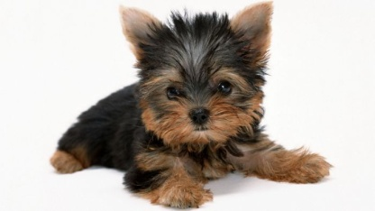
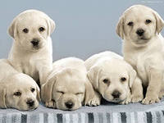
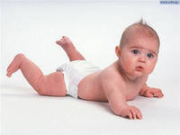
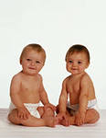
Consonant + y -ies
Puppy
Baby
Lady
Puppies
Babies
Ladies

Slide 6
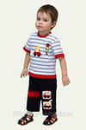
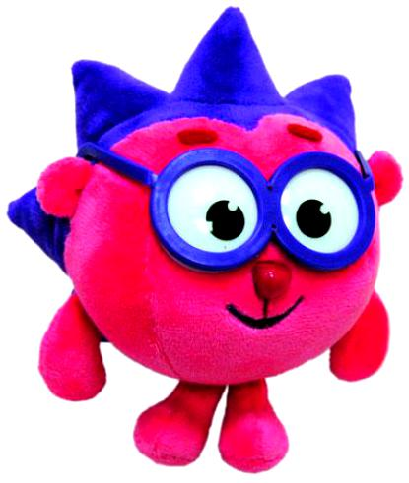
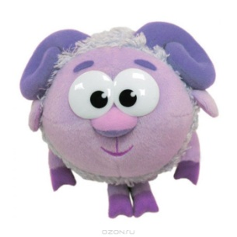
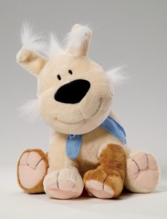
Vowel (a, e, i, o, u) + y -s
Singular
Plural
Boy
Toy
Boys
Toys

Slide 7
-f, -fe - ves
Singular
Plural
Leaf
Life
Leaves
Lives

Slide 8
BUT
ROOFS
HANDKERCHIEFS
DWARFS = DWARVES
SCARVES = SCARFS

Slide 9
Irregular Plurals
One man Three men
One woman Three women
One child Three children
One tooth Three teeth
One foot Two feet
One goose Three geese
One mouse Three mice
One sheep Three sheep

Slide 10
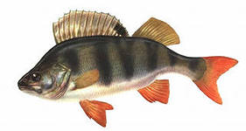
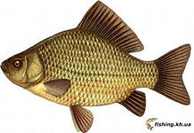
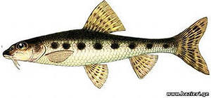
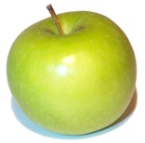
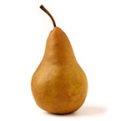
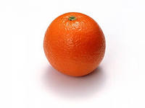
BUT
Three fish
One fish
Three fishes
Three fruit
One fruit
Three fruits

Slide 11
Drill
Put the nouns into a plural form:
tooth - … tomato - …
city - … roof - …
box - … apple - …
mouse - … child - …
forest - … country - …
wolf - … photo - …
key - … sheep - …

