Slide 1
The United Kingdom of Great
Britain and Northern Ireland
or
ENGLAND

Slide 2
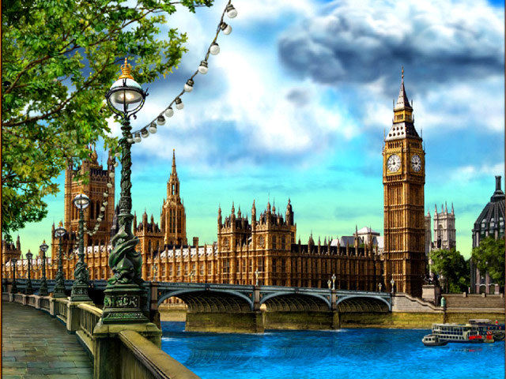
LONDON and Big Ben

Slide 3
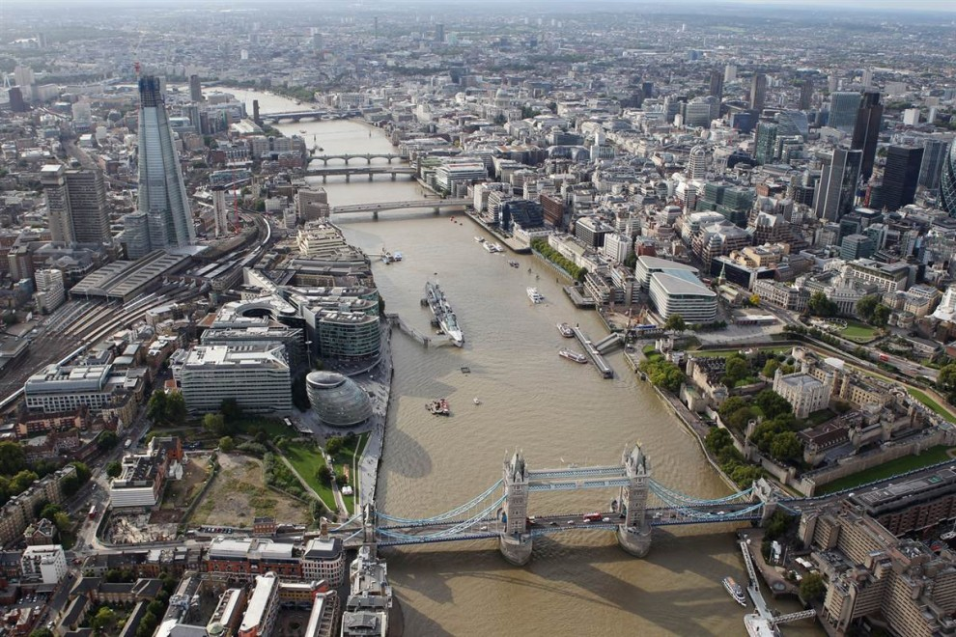
Thames

Slide 4
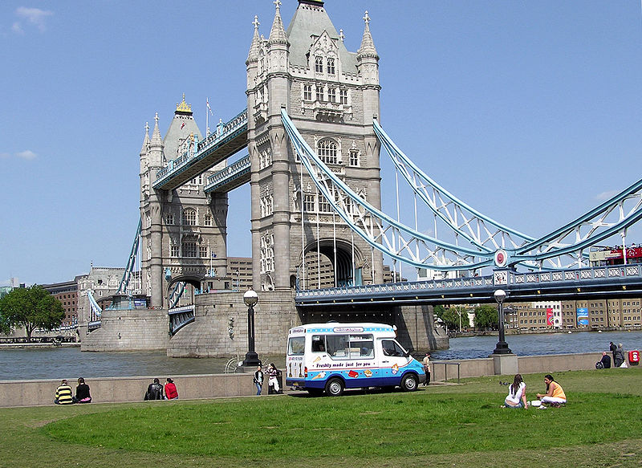
London Bridge

Slide 5
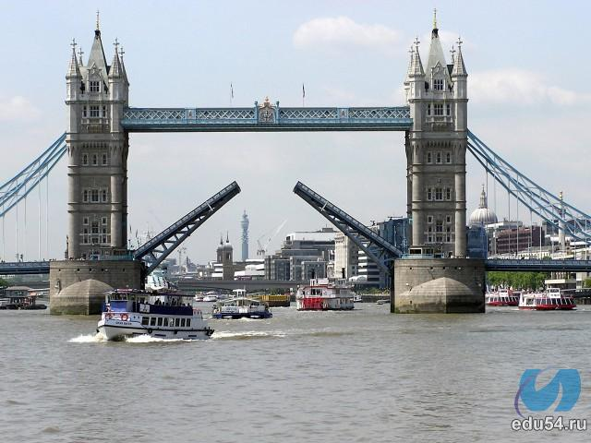
London Bridge

Slide 6
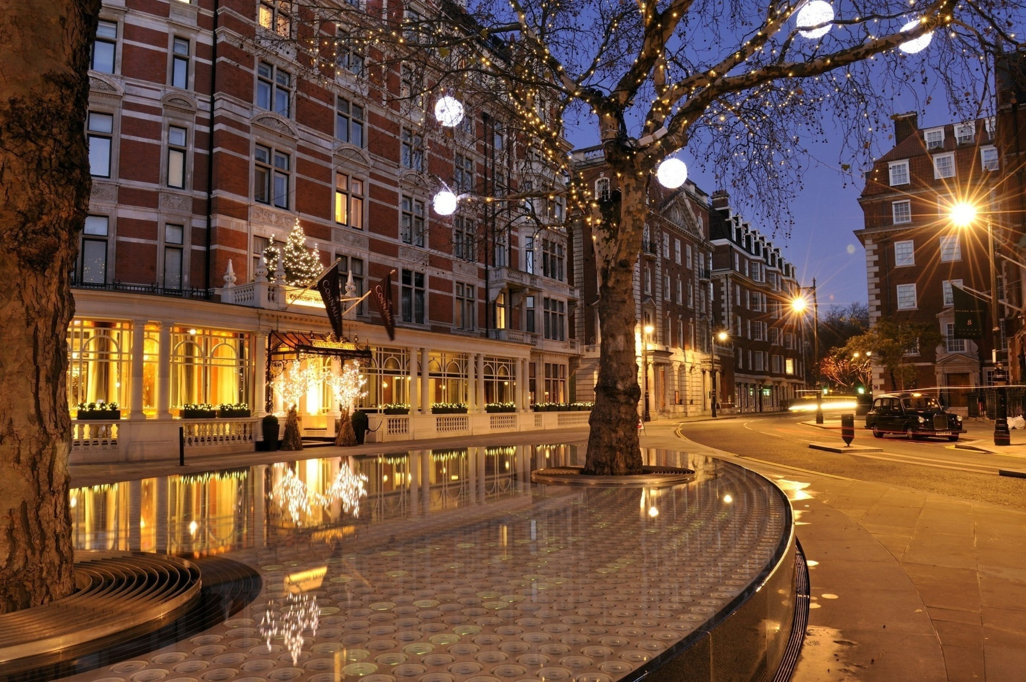
Westminster Abbey

Slide 7
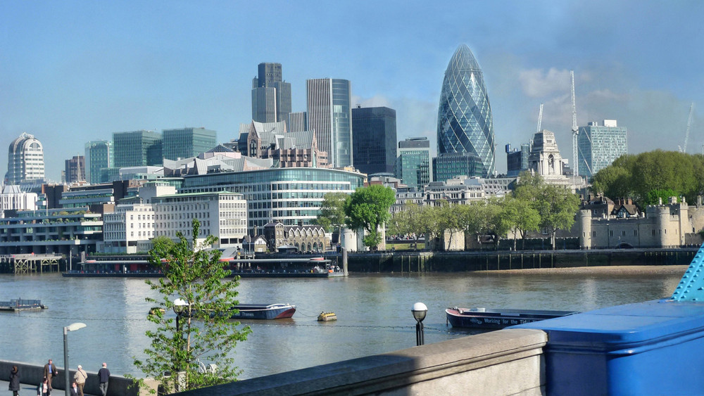
The City

Slide 8
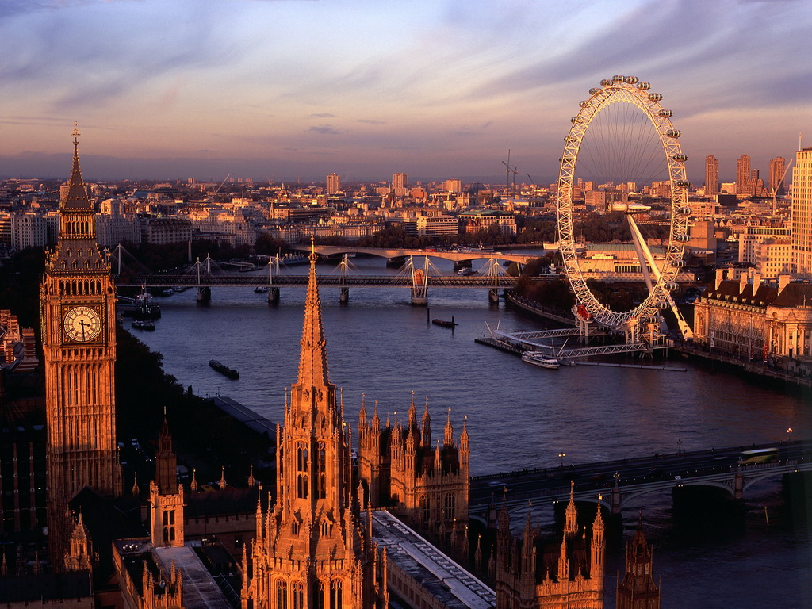
London Eye

Slide 9
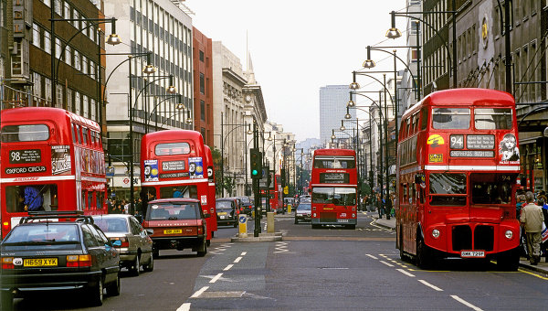
London buses

Slide 10
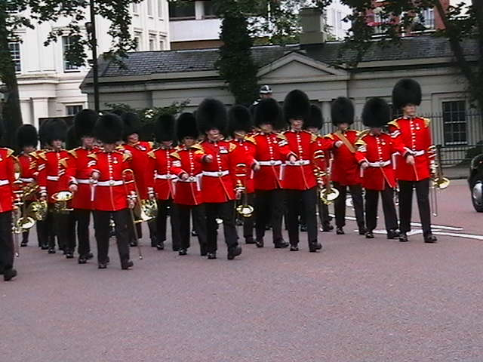
The guards

Slide 11
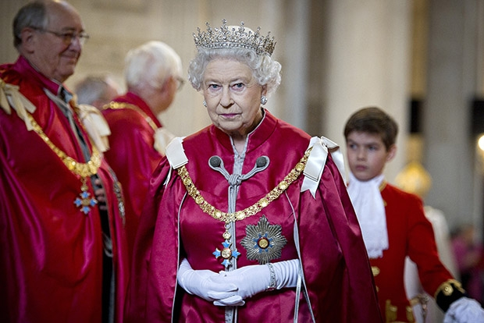
Queen Elizabeth The Second

Slide 12
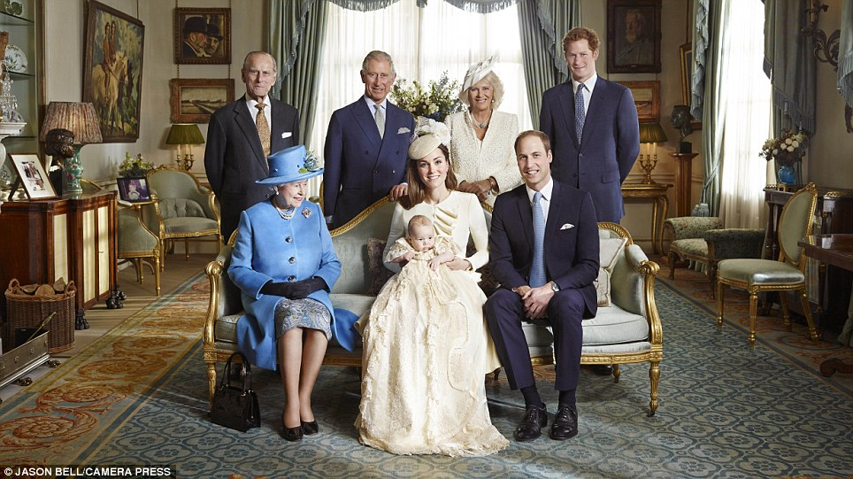
the Royal Family

