Slide 1
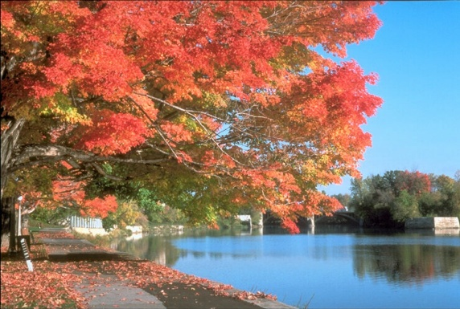
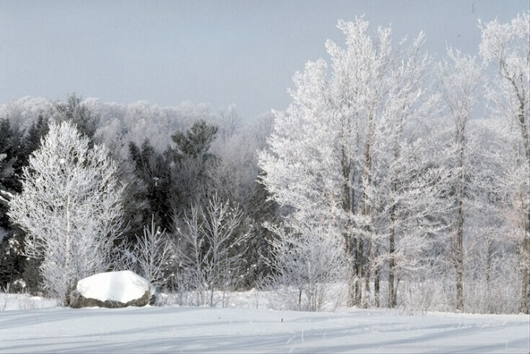
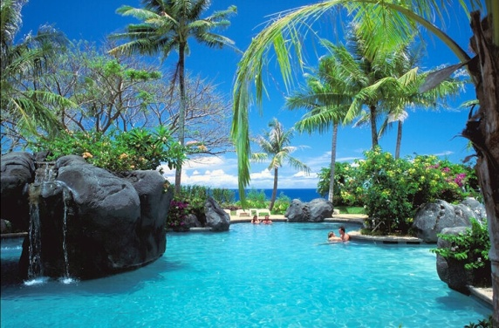
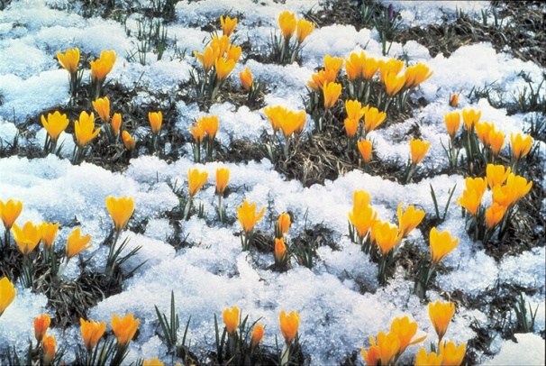
The English Year

Slide 2
English tongue twisters
Two tiny tigers take two taxis to town.
I wish you were a fish in my dish.
Fat Pat had a fat cat.
Pat’s fat cat sat in Pat’s hat.

Slide 3
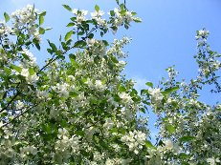
Фонетическая зарядка
Autumn is yellow.
Winter is white.
Spring is green.
Summer is bright.

Slide 4
Guess the months!
The first month is ….
In this month English people celebrate St.Valentine’s Day.
This month comes after April.
In this month school starts.
Before November comes.?.
In Russia summer months are…?..
7. In England people celebrate Christmas on this month.
8. The Fool’s Day we celebrate in ..?..
9. This month is the eleventh month of the year.
10. In ..?.. we celebrate the Mother’s Day.
Name all the months of the year: January, ……

Slide 5
Неопределенно-личные местоимения
Fill in the gasp with the correct pronoun:
1. Have you got ______tasty for breakfast?
2. -How do you feel?
-Not bad. ______ is OK.
3. There was ______in my schoolbag: no pens, no books , no pencils.
4. We have ________for you!!!!
Something (что-то)
Anything (что-нибудь)
Nothing (ничего)
Everything (всё)

Slide 6
Let’s remember the English year!
There are … seasons in the English year. They are winter, …., summer
and … .
Winter months are November, ..?..,..?.., and February.

Slide 7
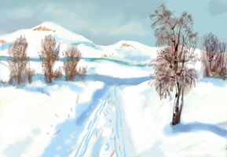
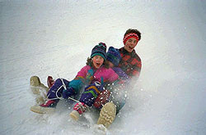
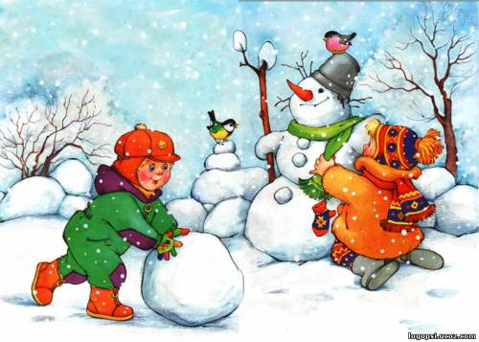
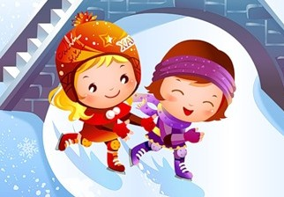
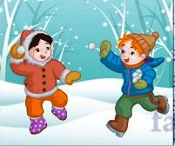
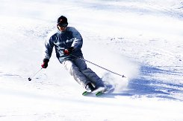
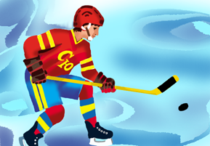
Winter
Children’s activities
Winter holidays

Slide 8
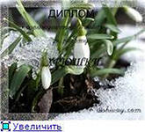
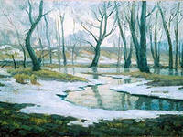
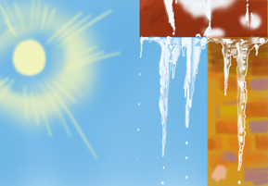
Spring
There are .... spring months in England. They are ....... and …....
….is the ……spring month. April is the …… spring…..In spring the days are …., and the….. are ……
It is usually ….
In March the English people …… .
In April they celebrate and

Slide 9
ВЕСНА
Есть 2 весенних месяца в Англии. Это март и апрель. Март-первый весенний месяц. Апрель-второй весенний месяц.
Весной дни длинные, а ночи короткие.
Весной обычно тепло.
В марте англичане празднуют Мамин День. В апреле они празднуют Пасху
и День Смеха.

Slide 10
HOME TASK: стр.116 упр.7, отвечать на вопросы по тексту «The English Year»

