Slide 1
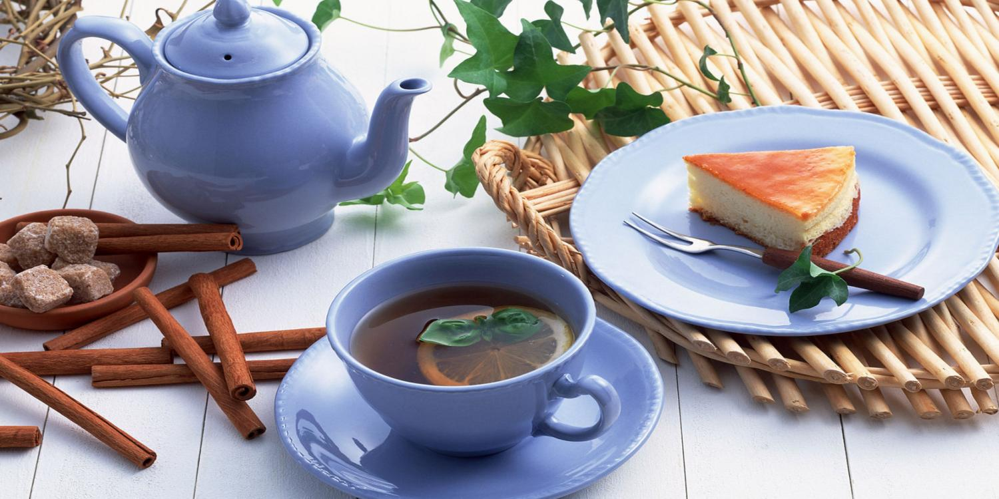
Tea Party

Slide 2
Tea, The Cure – All. If you are cold, tea will warm you. If you are too heated, tea will cool you. If you are too depressed, tea will cheer you. If you are too exhausted, tea will calm you. William Gladstone

Slide 3
Tea is the most popular drink in the world. It is refreshing, tasty and useful. It has no calories.

Slide 4
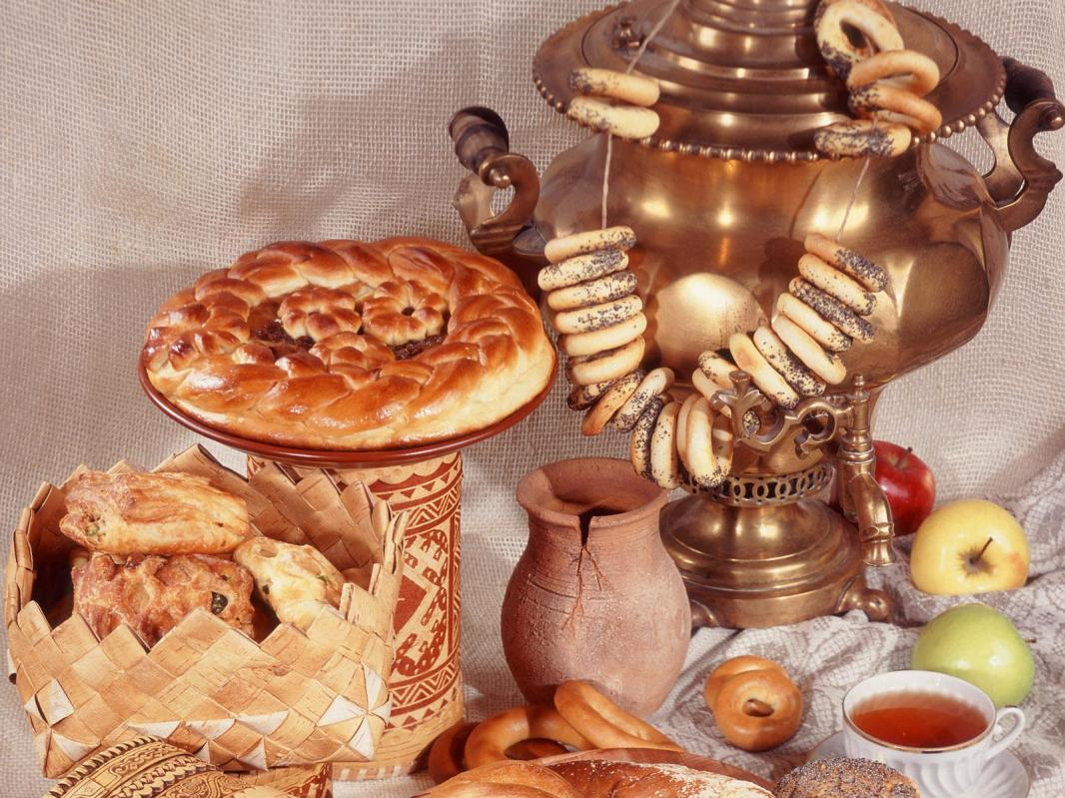
People in Russia like tea. They drink tea from samovars. They sit at the table around a big samovar with their friends.

Slide 5
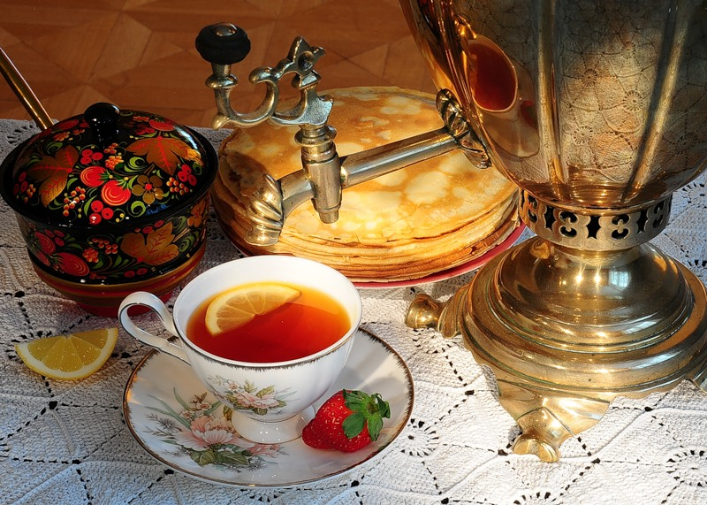
Our traditional national dish is pancakes. It’s fantastic to drink tea from the samovar and eat pancakes with honey and sour cream.

Slide 6
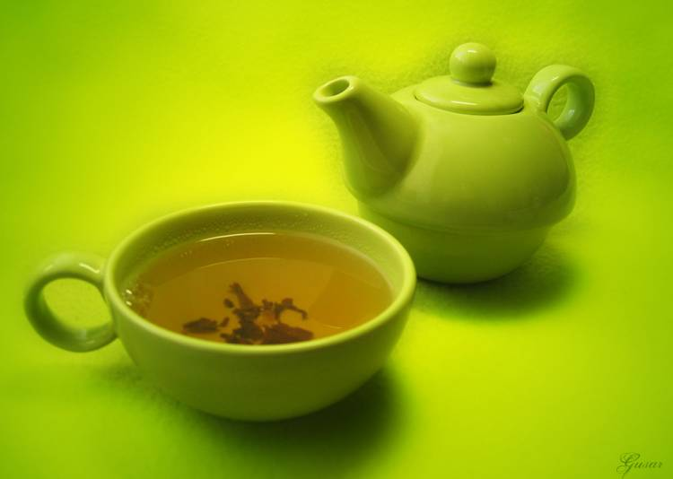
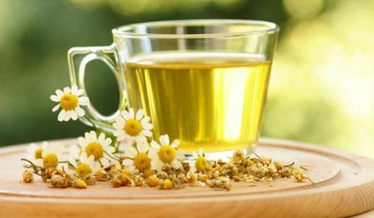
There are different sorts of tea: black, green, red, yellow. It is up to you what to choose.

Slide 7
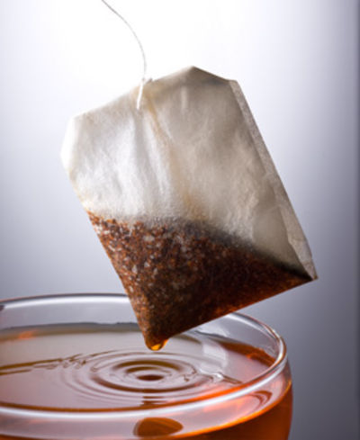
Nowadays a lot of people prefer packed tea. It is quickly, but not so tasty.

Slide 8
We have done public opinion poll among students of our school. 25 persons took part in it. The questions were: - What do you prefer tea or coffee? -What tea do you like?

Slide 9
Results of the public opinion poll
33%

Slide 10
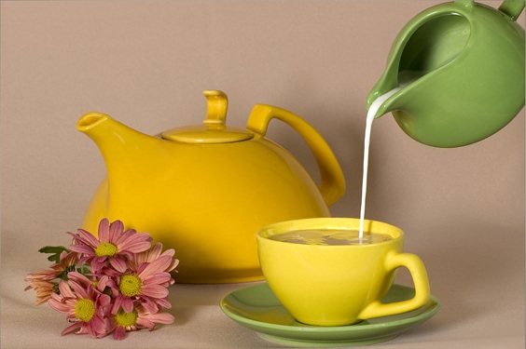
Tea with milk is more preferable. Tea with lemon is less popular.

Slide 11
16% students of our school drink pure tea, without milk, sugar or lemon.

