Slide 1
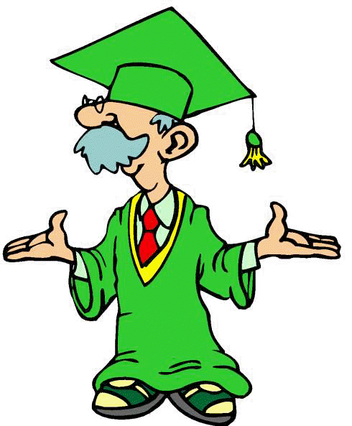
The 30th of October.
“The Future Simple Tense”

Slide 2
Maths Christmas
Art Spanish
English to wear
uniform science
language Literature
to study New Year

Slide 3
I have taught to

Slide 4
The game “ A boaster”.
1. I will visit London next summer.
(?) -Will you visit London next summer?
(-) -You will not visit London next summer.

Slide 5
I have taught to

Slide 6
Find a mistake:
1. We will usually go to my granny next Saturday.
2. There were 25 pupils in our class next year.
3. You will swim in the river tomorrow?
4. She not go abroad in an hour.

Slide 7
I have taught to

Slide 8
Let’s have a rest.

Slide 9
Make up the question:
You will take a book next week.
1/ What … ?
2/ When … ?
3/ Who … ?

Slide 10
I have taught to

Slide 11
Homework
s/b p.177 ex.35
(translate the text)

Slide 12
Give yourself a mark

