Slide 1
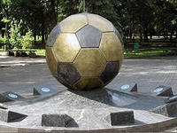
The ball from the pyramid or the history of football ГБОУ СОШ № 629 Завгородний Александр 4д Тарновская Татьяна 4г учитель английского языка ГБОУ СОШ № 629 Голубева Ю.П.

Slide 2
Football has been played all over the world for centuries, but no one really knows where or when it began.

Slide 3
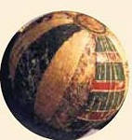
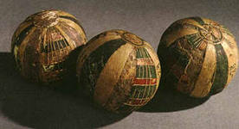
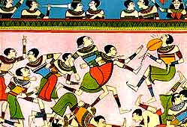
The Ancient Egyptians played ball games thousands of years ago.

Slide 4
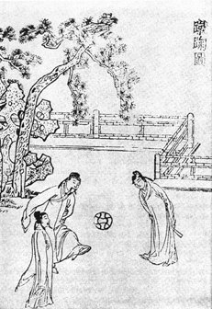
Years later, in China, they played a game called «tsu chu». The players had to kick a ball through a piece of cloth tied to two posts.

Slide 5
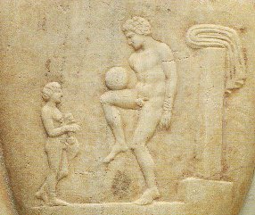
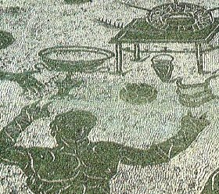
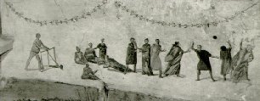
The Ancient Greeks and Romans played ball games at the Olympics, too.

Slide 6
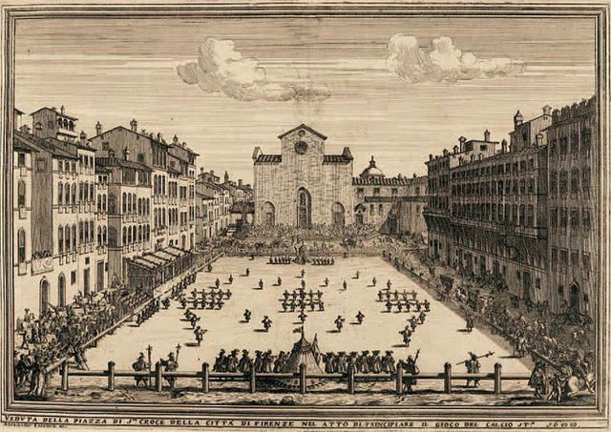
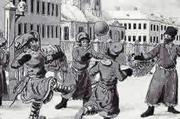
By the year 1200 ball games existed in Europe.

Slide 7
Whole towns and villages played against each other. Sometimes there were more than 100 players in a team!

Slide 8
For the next five hundred years Kings in Britain and France tried to ban football because it was so wild.
The first rules were introduced in 1848.
The first football club in the world, Sheffield FC, was formed in 1857.

Slide 9
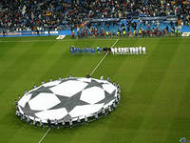
Modern football quickly travelled from Europe to other continents and today it is the most popular sport in the world.

Slide 10
and some Football Terms to finish with
Team is a group of eleven people who play football together.
A team plays against another team - their rivals
A team with the most goals wins the game.
To score a goal a player has to kick the ball into the net.
Striker-the player who tries to score goals.
Defender-is a player who tries to stop the other team.
People watch the matches – they support one of the team.
People cheer loudly when their team wins.

Slide 11
Thank you for your attention
Используемые ресурсы:
http://learnenglishkids.britishcouncil.org/ru/word-games/order-the-sentences/the-history-football
http://learnenglishkids.britishcouncil.org/ru/word-games/fill-the-gap/football
http://eosof.ru/publ/2-1-0-7

