Slide 1
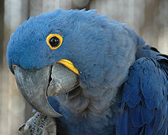
BIG parrot.
Проект выполнила Гришко София
Ученица 4 «Б» класса.

Slide 2
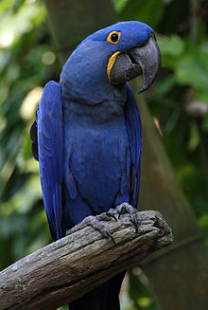
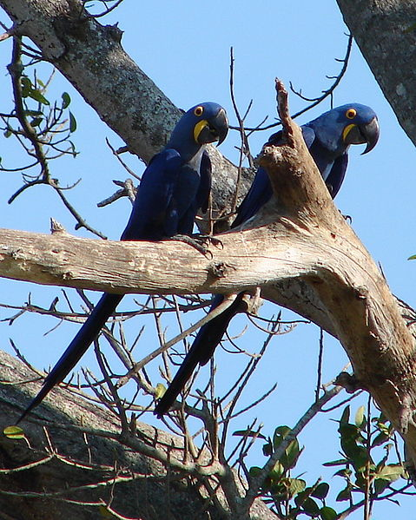
This Parrot is the largest parrot in the world. It is bright blue. In height it is almost a meter. And it has got a powerful beak.

Slide 3
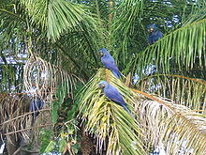
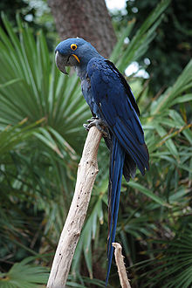
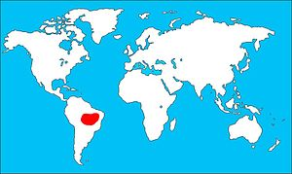
They live in the forests of Brazil.

Slide 4
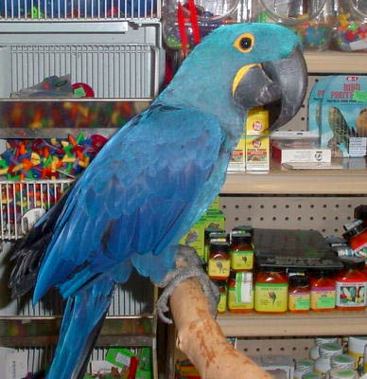
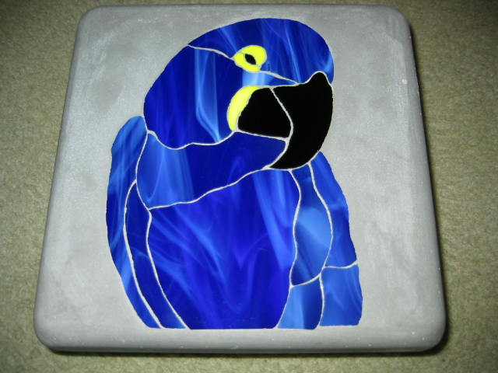
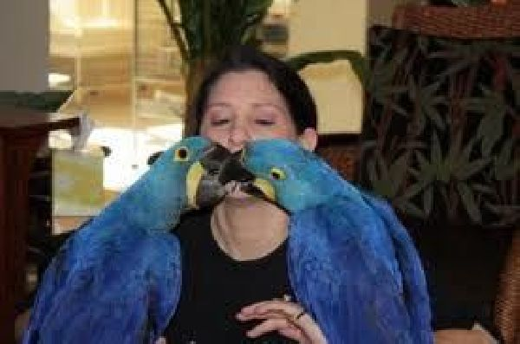
People love parrots. They are the most popular pets.

Slide 5
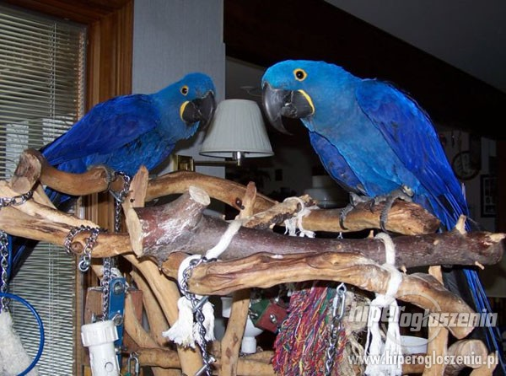
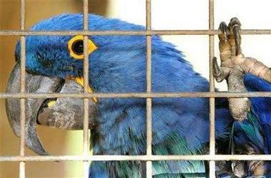
So, their natural is becoming less and less.
Save parrots, do not buy them!!!!

