Slide 1
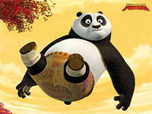
Panda
Выполнил ученик 4 «Б» класса
Школы №541
Красников Александр

Slide 2
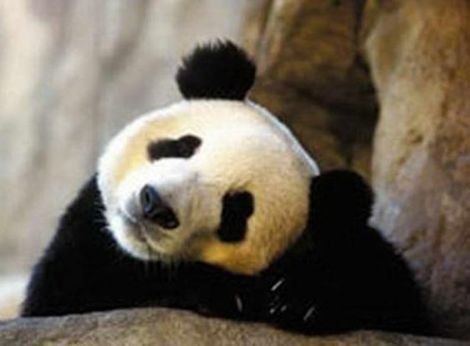
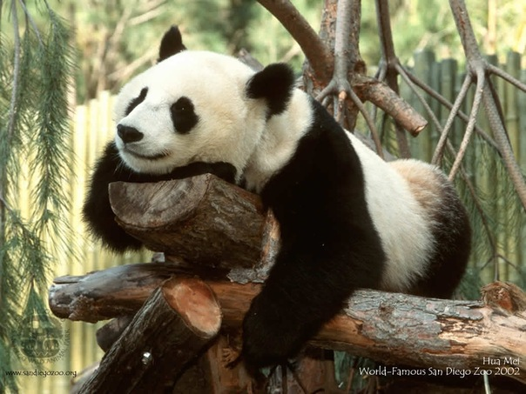
PANDAS IN DANGER

Slide 3
Pandas are special animals because they are the only pandas that can live in the jungle .They live in China .The sad thing is that there are seven hundred thousand these days. Panda can find bamboos they need in huge quantities of bamboo leaves.

Slide 4
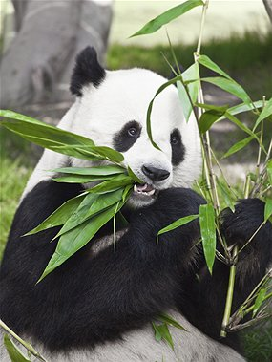

Slide 5
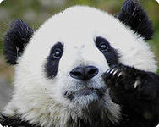
Thanks

