Slide 1
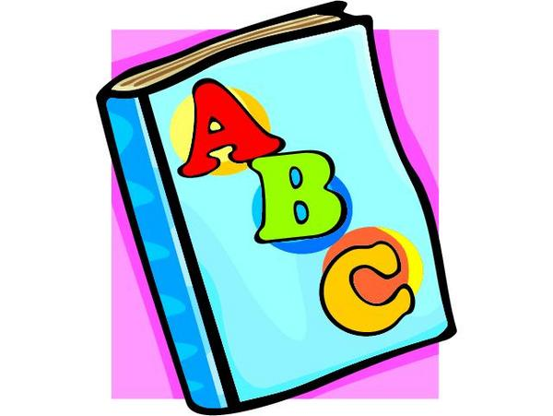
Let’s speak English!

Slide 2
How are you today?
Fine, thanks!
Not bad, thanks!

Slide 3
[æ]
[i]
[e]
[ɒ]
[ʊ]
[i:]
[u:]
[ɔ:]
[k]
[b]
[t]
[ð]
[θ]
[h]

Slide 4
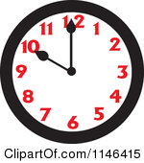
“Tick-tock”, says the clock,
Tick-tock, it’s ten o’clock.

Slide 5
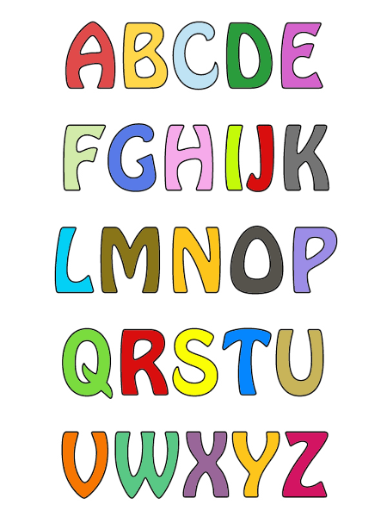

Slide 6
[ei]
[ǝʊ]
[ɔi]

Slide 7
ee [i:] – bee
ea [i:] - tea
oo [u:] - boot
[ʊ] - book
oa [ǝʊ] - boat

Slide 8
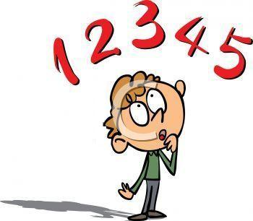
1
2
3
4
5
8
9
10
6
7

Slide 9
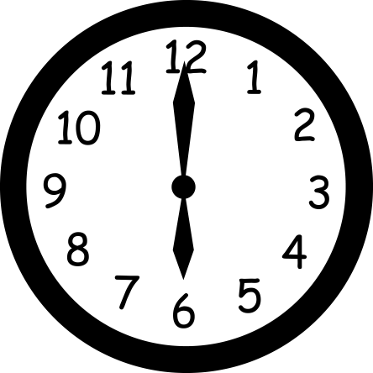
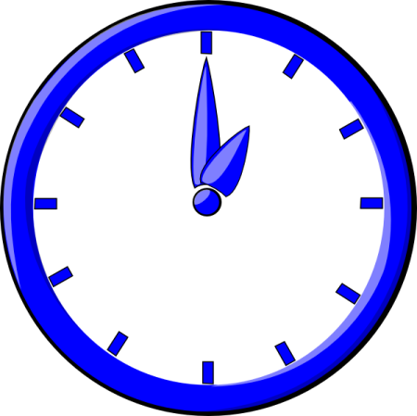
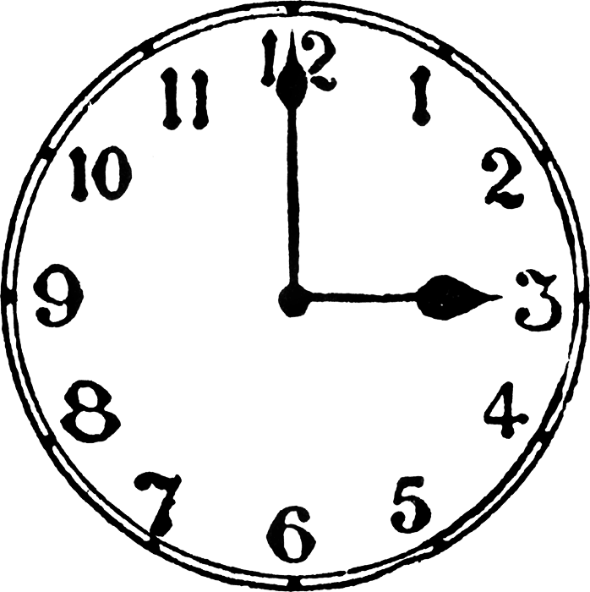
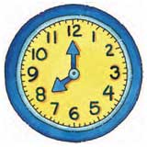
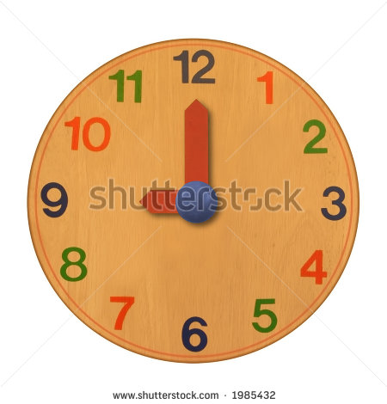
Time
5 o’clock [ ǝ’klɔk] – пять часов

Slide 10
[i:]
bee

Slide 11
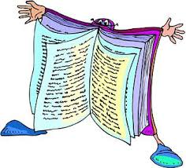
[ʊ]
book

Slide 12
boot
[u:]

Slide 13
hat
[æ]

Slide 14
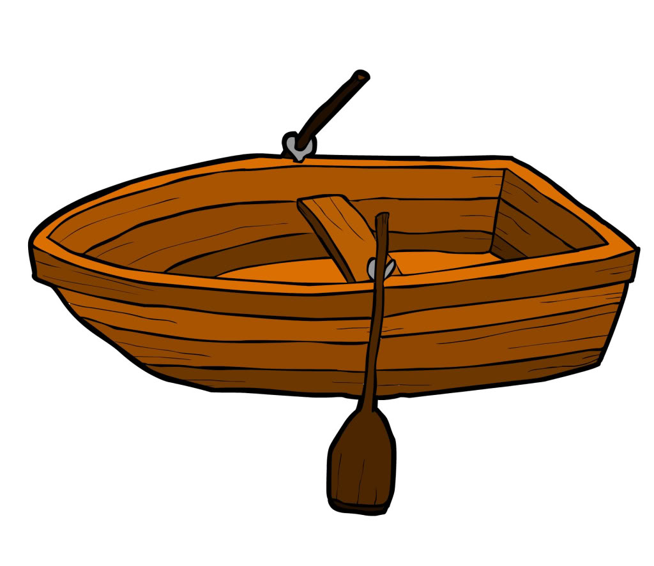
boat
[ǝʊ]

Slide 15
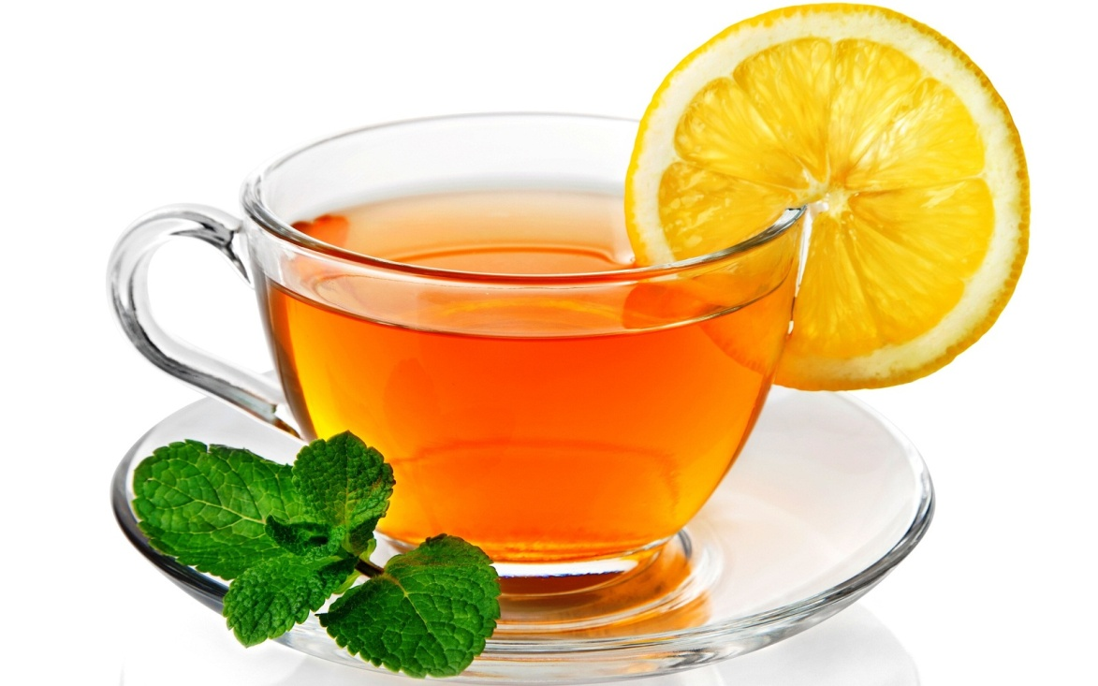
tea
[i:]

Slide 16
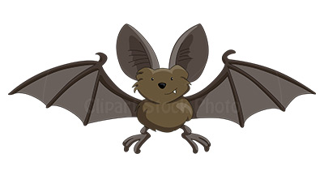
bat
[æ]

