Slide 1
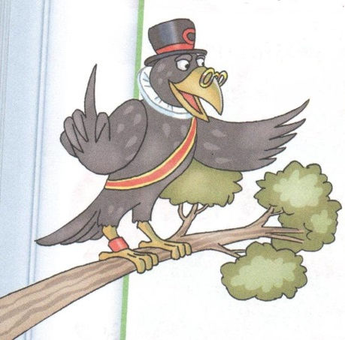
Let’s read English!
2nd form

Slide 2
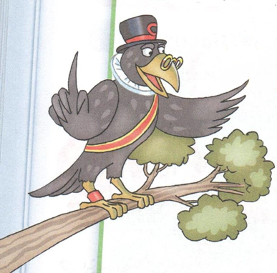
I see Sam. He has got a red pen.
– Hi! I am Sam. I like cakes.

Slide 3
I see Bob. He has got a bag.
– Hi! I am Bob.

Slide 4
I see a dog.
– Hi! I am a dog. I am big and black.

Slide 5
– And I am a bee!

Slide 6
He has got a fox.
The fox is big and red.
The fox is not five.
It is six.

Slide 7
I am in the zoo.
I can see a zebra.

Slide 8
I am Tim.
I am not Tom.
I have got a cat. My cat is not big.

Slide 9
He is Tom. Tom is not sad.
Tom has got a dog. It is black.

Slide 10
We like sweets.

