Slide 1
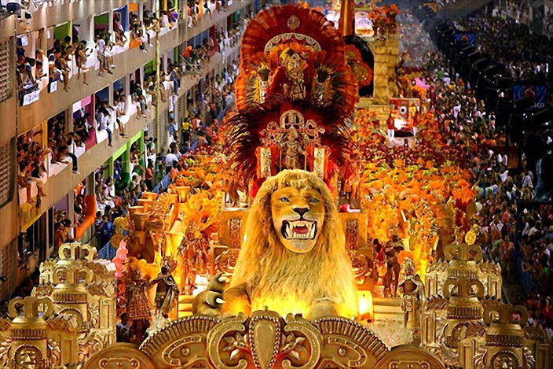
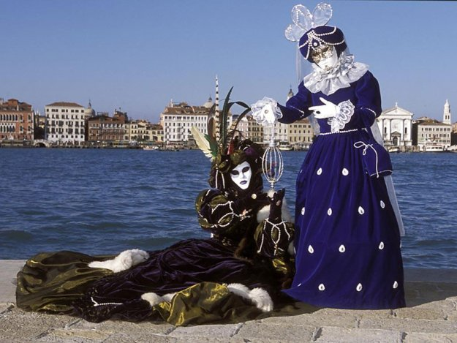
Carnival
Carnival is a festive season which occurs immediately before Lent; the main events are usually during February. Carnival typically involves a public celebration or parade combining some elements of a circus, mask and public street party. People often dress up or masquerade during the celebrations, which mark an overturning of daily life.
Carnival in Rio de Janeiro
Carnival of Venice

Slide 2
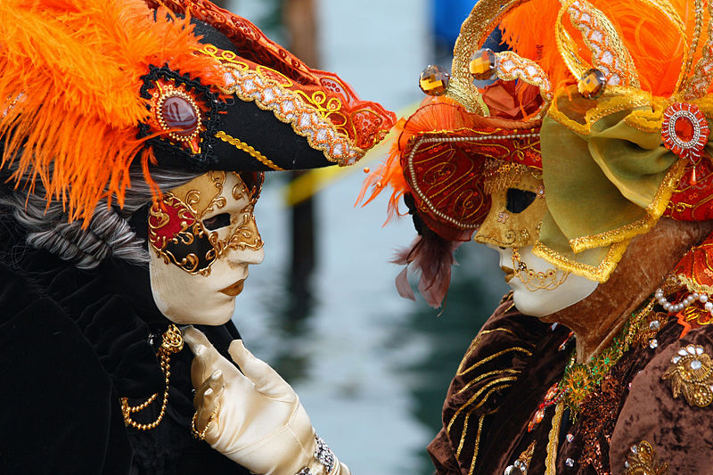
Carnival of Venice
The Carnival of Venice is an annual festival, held in Venice, Italy. The Carnival starts 40 days before easter and ends on Shrove Tuesday (Fat Tuesday or Martedì Grasso), the day before Ash Wednesday.

Slide 3
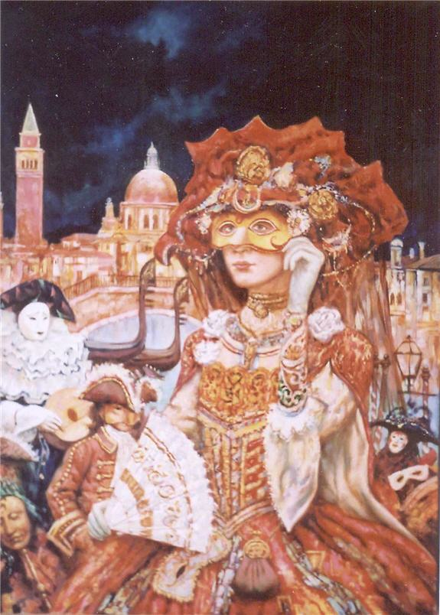
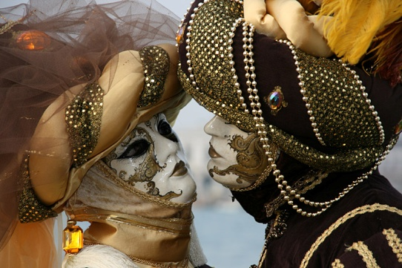
History
Carnival started as a time for celebration and expression throughout the classes, as wearing masks hid any form of identity between social classes.
Today, approximately 30,000 visitors come to Venice each day for Carnivals. One of the most important events is the contest for the best mask, placed at the last weekend of the Carnival.

Slide 4
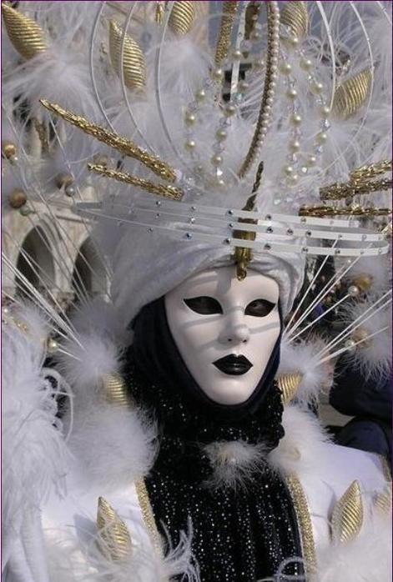
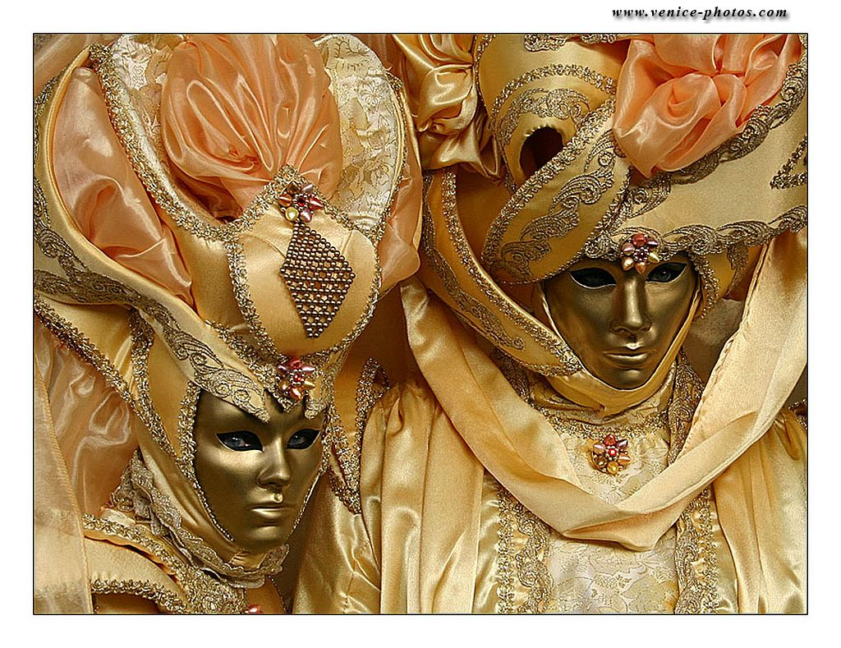
Venetian carnival masks
Masks have always been a central feature of the Venetian carnival; traditionally people were allowed to wear them between the festival of Santo Stefano (St. Stephen's Day, December 26) and the start of the carnival season and midnight of Shrove Tuesday. They have always been around Venice.

Slide 5
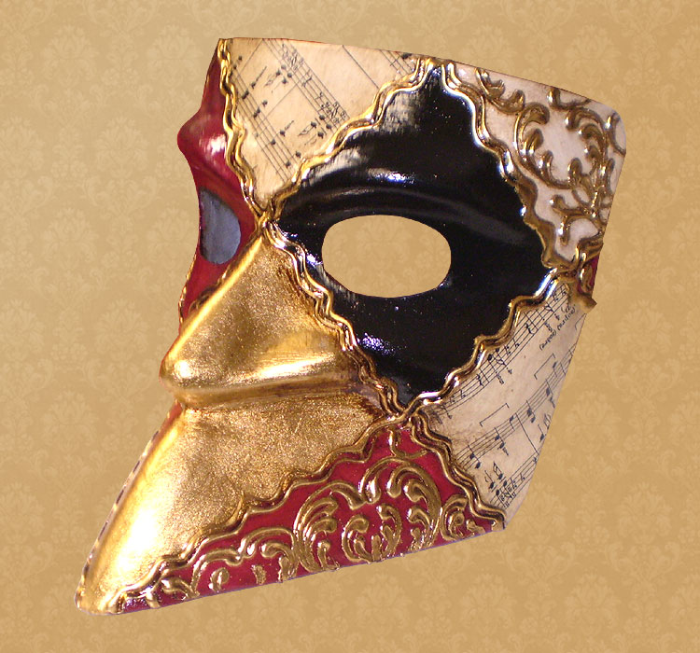
Bauta
Bauta (sometimes referred to as baùtta) is the whole face, with a stubborn chin line, no mouth, and lots of "gilding".
It tends to be the main type of mask worn during the Carnival. It was used also on many other occasions as a device for hiding the wearer's identity and social status.

Slide 6
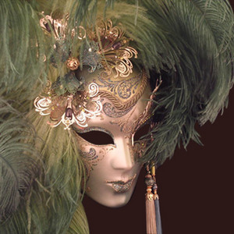
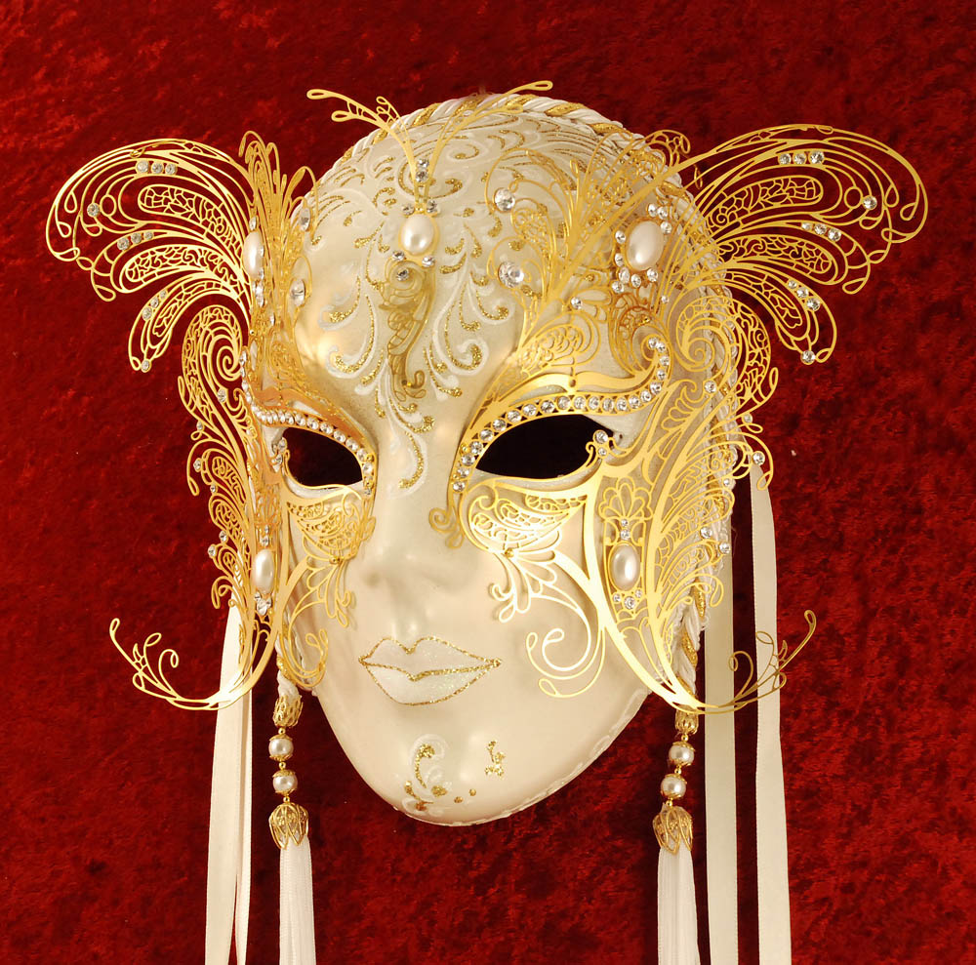
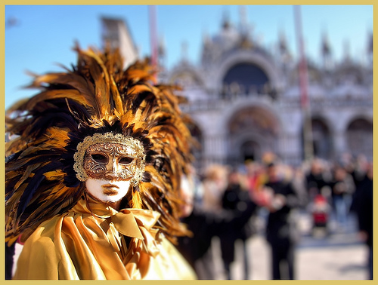
Volto or Larva
The "Volto" was the more common mask used in Venice for centuries. Volto means "face", and it was the simplest mask to produce.

Slide 7
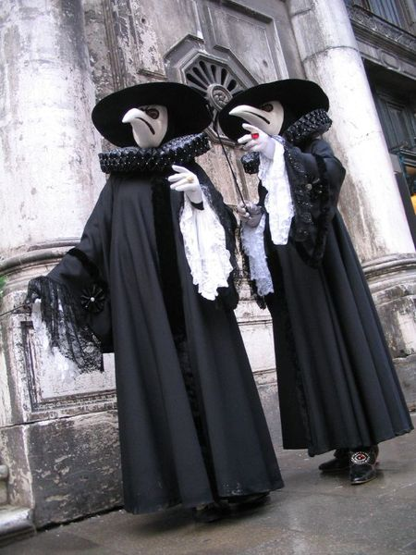
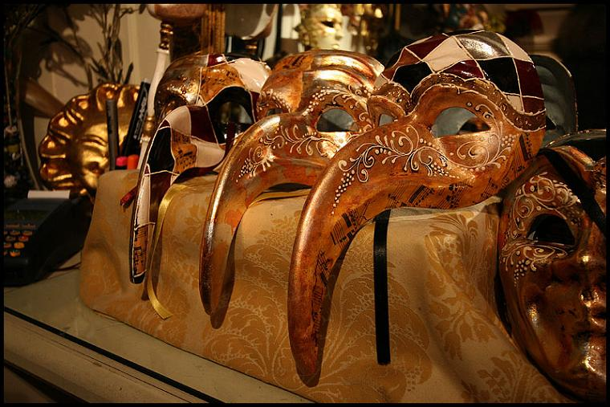
Medico Della Peste (The Plague Doctor)
The Medico Della Peste with its long beak is one of the most bizarre and recognisable of the Venetian masks. The striking design has a macabre history originating from 17th century French physician Charles de Lorme who adopted the mask together with other sanitary precautions while treating plague victims.

Slide 8
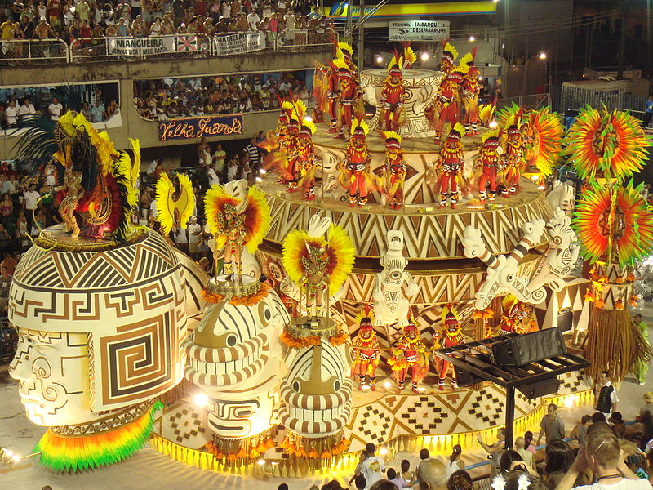
Rio Carnival
The Carnival in Rio de Janeiro is a world famous festival held before Lent every year and considered the biggest carnival in the world with two million people per day on the streets. The first festivals of Rio date back to 1723.

Slide 9
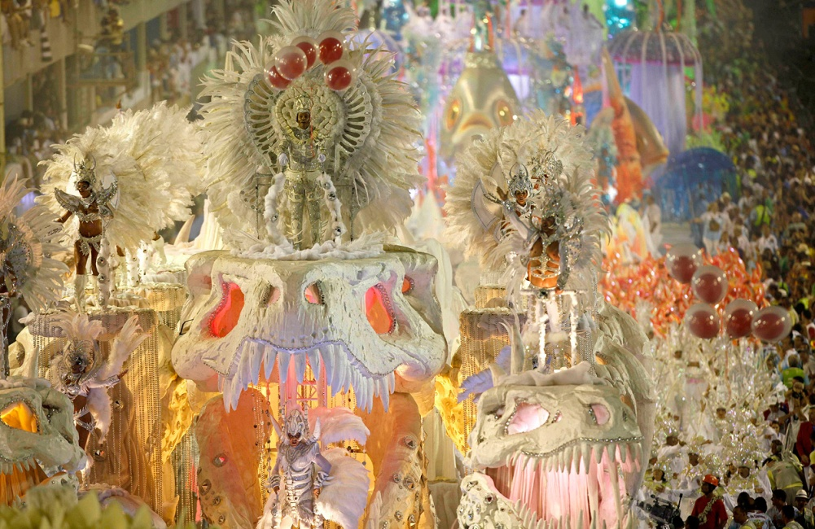
Block parades have become an expressive feature of Rio's Carnival. Today, they number more than 100 and the groups increase each year. Before the show, they gather in a square, then parade in sections of the city, often near the beach. Block parades start in January, and may last until the Sunday after Carnival.

Slide 10
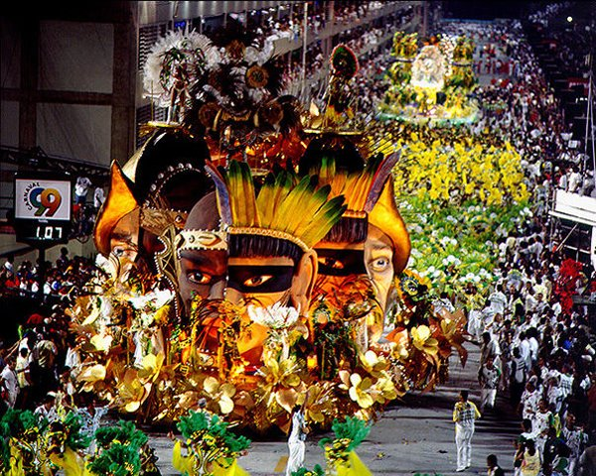
As the parade is taking place in the Sambadrome and the balls are being held in the Copacabana Palace and beach, many of the carnival participants are at other locations. Street festivals are very common during carnival and are highly populated by the locals. Elegance and extravagance are usually left behind. Anyone is allowed to participate in the street festivals.
Street carnival

Slide 11
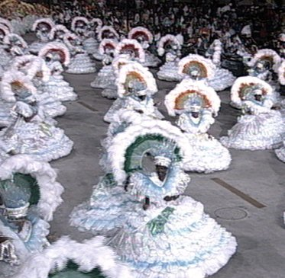
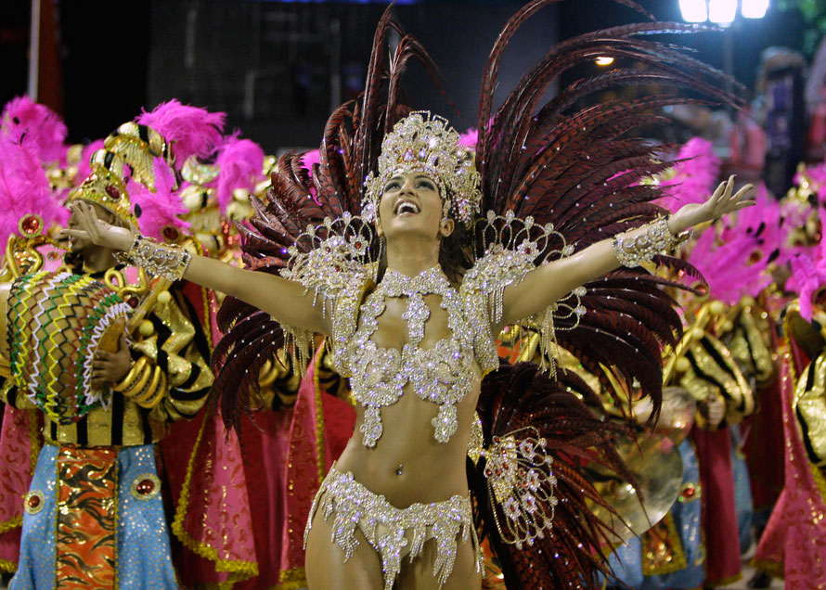
Music and dance
Dancers at the 2005 carnival
Incorporated into every aspect of the Rio carnival are dancing and music. The most famous dance is the samba, a brazilian dance with african influences. The samba was created by the African slaves mixing with the choros, street bands, of Brazil. Other dances include the lundu, the polka, and the maxixe.

Slide 12
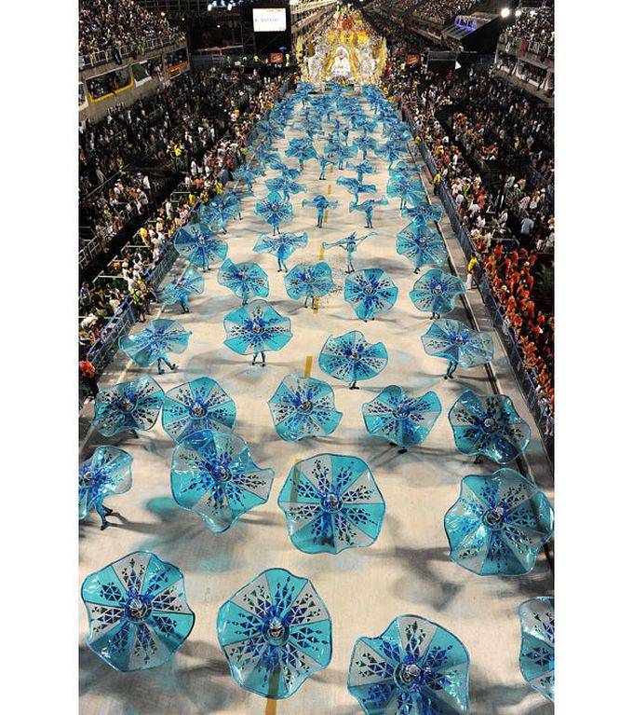
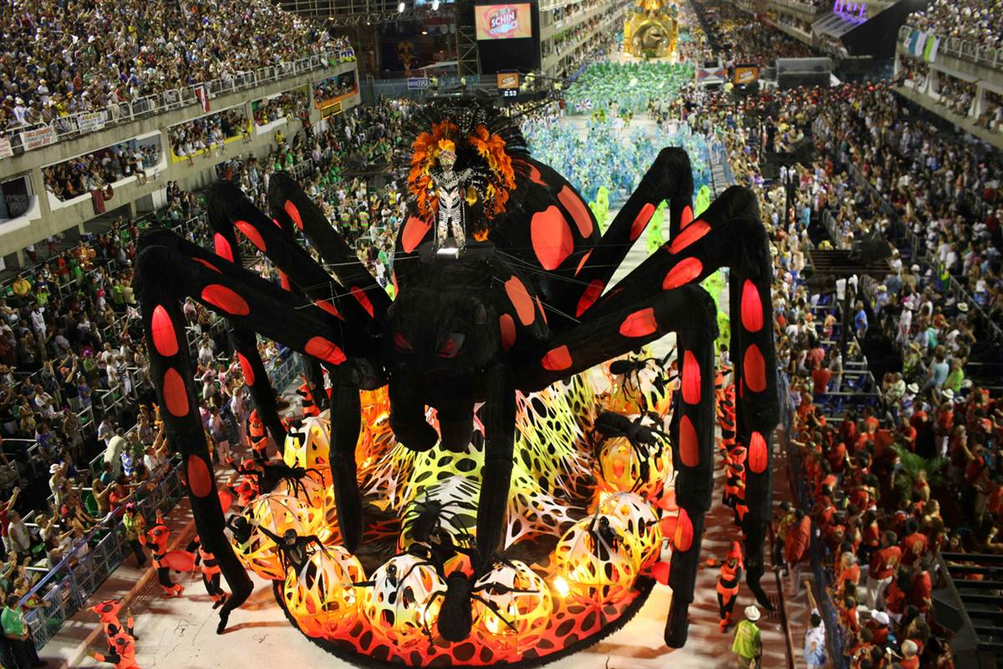
Instruments of carnival
Before the samba gained the percussive style, it was played with flutes and string instruments because percussion was looked upon as corrupt. It was in 1930 that the shift came to allow for percussion instruments. There is an ensemble of drum and percussion players that are led by a man that plays an apito, a whistle used to control the music.

