Slide 1
Tenses of the English verb.
Present
Future
Past
Учитель английского языка МБОУ Гимназия №4 Кстово Манукян Евгения Валентиновна

Slide 2
Active
Passive
Future
Past
Present
Simple
Progressive
Perfect

Slide 3
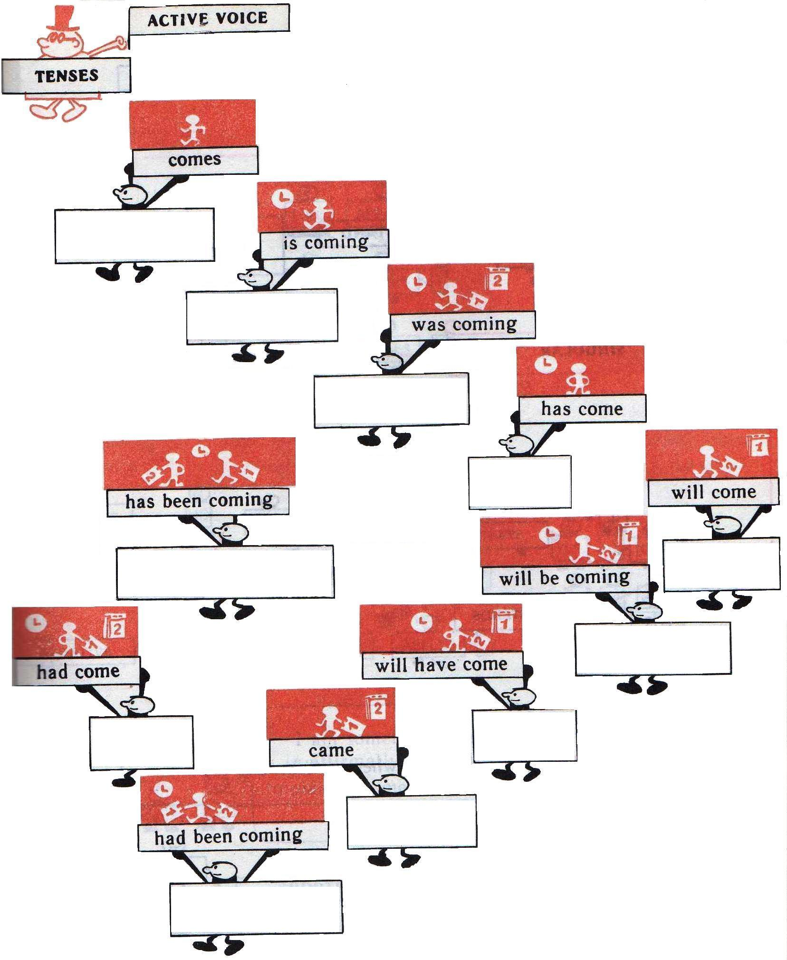
Tenses
Present Simple
Present
Progressive
Past
Progressive
Present
Perfect
Present Perfect
Progressive
Future
Simple
Future
Progressive
Past
Perfect
Future
Perfect
Past
Simple
Past Perfect
Progressive

Slide 4
Present Simple
-S
DO
DOES
singular
plural
I
stand
YOU
you
HE
WE
stand
SHE
stand
THEY
s
IT

Slide 5
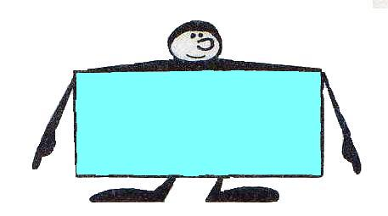
I
like
apples
don't
not
apples
You
do
like
Do
you
like
apples
?

Slide 6
He
like
apples
s
he
like
apples
?
Does
s
He
not
apples
doesn’t
does
like
s

Slide 7
Present Simple
often
sometimes
every day
always
usually
seldom
I
often
play
football
He
chess
every day
play
s

Slide 8
My friend …..plays basketball.
Tom and Willy play chess…..
Their brothers……watch TV after school
I…..go shopping with mum.
We listen to music….
Betty dance in the club….
Always, often, every evening, usually, every day, on Saturdays.

Slide 9
Собери предложения из
человечков одного цвета.
friend
homework
doesn’t
always
to school
cooking
helps
I
like
you
They
don't
often
She
day
My
every
do
go
mother
Do
like
sport

Slide 10
Past Simple
irregular
regular
V
V
(2)
(ed)
finished
go-
went

Slide 11
Формы неправильных глаголов:
1 форма | 2 форма | 3 форма
To be To begin To break To buy To cut To do To drink To find To get To give To go To have To hear To meet To say To see To speak To swim To take To write | was, were began broke bought cut did drank found god gave went had heard met said saw spoke swam took wrote | been began broken bought cut done drunk found gotten/got given gone had heard met said seen spoken swum taken written

Slide 12
go
 | finished
have
 | saw
break
 | helped
find
 | ate
sleep
 | ran
live
 | wrote
visit
 | drew
drive
be

Slide 13
A Gingerbread Man
Many years ago there (live) an old woman. One day she ( cook ) a gingerbread man. He ( be) very happy and ( go) for a walk. On the way he ( meet ) a cow and she (give) him some milk. He ( thank ) her and they ( go) to the forest. In the forest they ( meet ) a dog and (play ) with him. Then they (see )a cat. The cat (want) to play with them too. And they ( play )games till evening. Then the gingerbread man (take) his new friends home and the old woman (be ) very happy. Now she (have ) a cow, a dog and a cat.

Slide 14
did
?
regular
irregular
Did +V
?
(1)
Did you finish the work?
Did he go to the club last night?

Slide 15
Выберите нужную форму глагола.
Did you (swim/swam) last summer?
Did you (saw/see) your friends yesterday?
Did they (visit/visited) Granny last weekend?
Did his brother (did/do) the work yesterday?
Did your teacher (give/gave) them a test last lesson?
Did she (went/go) to school last week?
Did your friend (come/came) home at 6 o’clock yesterday?
Did Nick (washed/wash) the dishes?
Did you (have/had) breakfast yesterday morning?
Did Alice (watch/ watched) TV last night?

Slide 16
Задайте общие вопросы.
1.She skated yesterday.
……..she…… yesterday?
2.They worked in this pet shop.
……they…….in this pet shop?
3.Kate cleaned her room.
…..Kate…… her room?
4.He went to the cinema last night.
…..he…… to the cinema last night?
5.My parents saw him at the club yesterday.
…. My parents…… him at the club yesterday?
6.We had a test last lesson.
……we…… a test last lesson?

Slide 17
Did
regular
irregular
didn’t +V
(1)
didn’t finish
didn’t go

Slide 18
Сделайте предложения отрицательными.
1.They found the ball.
2. We did the test.
3. His sister finished this task.
4. Mike and Alice went to the cinema.
5. She washed all dishes after dinner.
6. Our class wrote a letter to the President.
7. Nancy visited her Granny last weekend.

Slide 19
To be
Did
were
was
We were in Moscow last summer.
I was at the concert.
I was not (wasn’t) at the concert.
They were not (weren’t) in Moscow last summer.
Was he at the concert?
Were you in Moscow last summer?

Slide 20
Future Simple
I,WE
(‘ll)
WILL
HE, SHE, IT, YOU, THEY
SHALL
Shall
Will
=(‘ll)
+V

Slide 21
I shall read the text.
I’ll read the text.
They will play football.
They’ll play football

Slide 22
We’ll visit you tomorrow.
We shan’t visit you tomorrow.
Shall we visit you tomorrow?
He’ll finish the work next week.
He won’t finish the work next week.
Will he finish the work next week?

