Slide 1
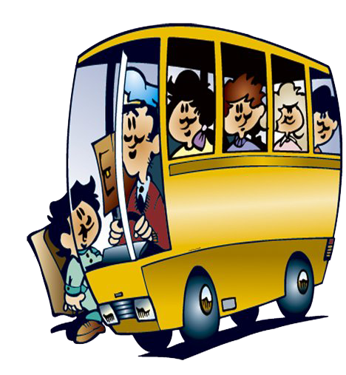
Past Simple Tense

Slide 2
Remember!
Простое прошедшее время
(Past Simple Tense)
обозначает действия, которые произошли в прошлом

Slide 3
Remember !
Правильно говорить о том,
что действие произошло
в прошлом тебе помогут
глаголы во II форме (V2) или
добавляем -ed

Slide 4
Все глаголы делятся на
правильные и неправильные
правильные
like – liked
watch – watched
play – played
count – counted
неправильные
sleep – slept
swim – swam
go – went
have – had

Slide 5
Remember!
Слова-спутники
прошедшего времени:
yesterday - вчера
the day before yesterday - позавчера
last month – в прошлом месяце
last year – в прошлом году
last week – на прошлой неделе
a year ago – год назад
a week ago – неделю назад
in 2009 – в 2009 году

Slide 6
Compare:
I go to school every day
Boys play football.
Grandma watches TV in the living room.
I went to school yesterday.
Girls played volleyball.
Mom watched a film.

Slide 7
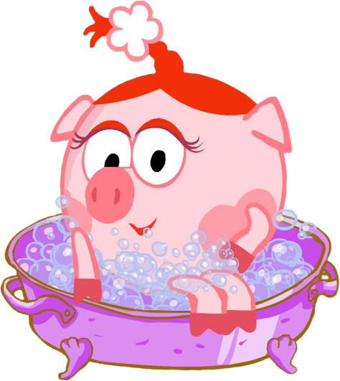
Расскажите о том,
что вы делали вчера
с друзьями

Slide 8
Глагол – связка to be
I, He, She, It
We, You, They
was
were

Slide 9
В утвердительных предложениях:
I was at home yesterday.
В отрицательных предложениях:
I was not at home yesterday.
В общем вопросе:
Were you at home yesterday? (Глагол ставится на первое место? Меняется местоимение.)
Ответ: Yes, I was. No, I wasn’t.
В специальном вопросе:
Where were you yesterday?
Ответ: I was at home yesterday.
Вопрос к подлежащему:
Who was at home yesterday?
Ответ: I was at home yesterday.
Разделительный вопрос:
You were at home yesterday, weren’t you?
Ответ: Yes, I was. No, I wasn’t.

Slide 10
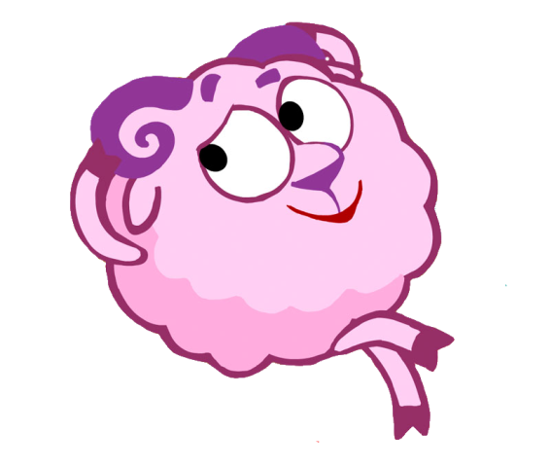
Как задать вопрос?
Was he happy?
Were they happy?

Slide 11
Отрицательные формы
was not = wasn’t
were not = weren’t

Slide 12
He
in the park.
was
not
We
in the park.
were
not

Slide 13
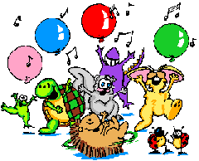
Как составить вопросительное предложение
was
happy.
?
He
were
happy.
?
They

Slide 14
Составьте вопросительные предложения
We were in the park last Sunday.
Were we in the park last Sunday?
They were very happy.
Were they very happy?
He was a very good boy.
Was he a very good boy?
I was at school yesterday.
Were you at school yesterday?

Slide 15
Remember!
Чтобы задать вопрос или составить
отрицательное предложение на помощь
приходит вспомогательный глагол
did

Slide 16
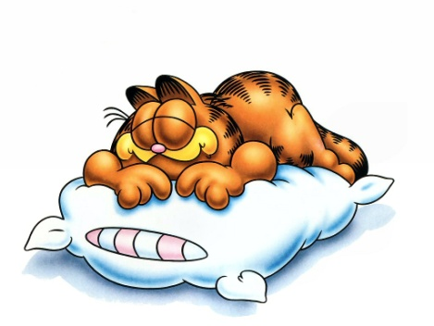
A cat
slept
yesterday.
sleep
yesterday
?
Did
a cat
did not
sleep
A cat
yesterday.

Slide 17
Задайте вопросы
My father went to the cinema yesterday.
Did my father go to the cinema yesterday?
His sister bought a new dress last week.
Did his sister buy a new dress last week?
A dog ate a bone.
Did a dog eat a bone?

Slide 18
Галишникова Гульнара Гаязовна
учитель английского языка
МБОУ СОШ № 7
Г. Сургут
Презентация может быть использована
для объяснения и тренировки Past Simple Tense
Использованные ресурсы:
http://www.futajik.ru/tag/multyashki/
http://1smeshariki.ru/oboi/

