Slide 1
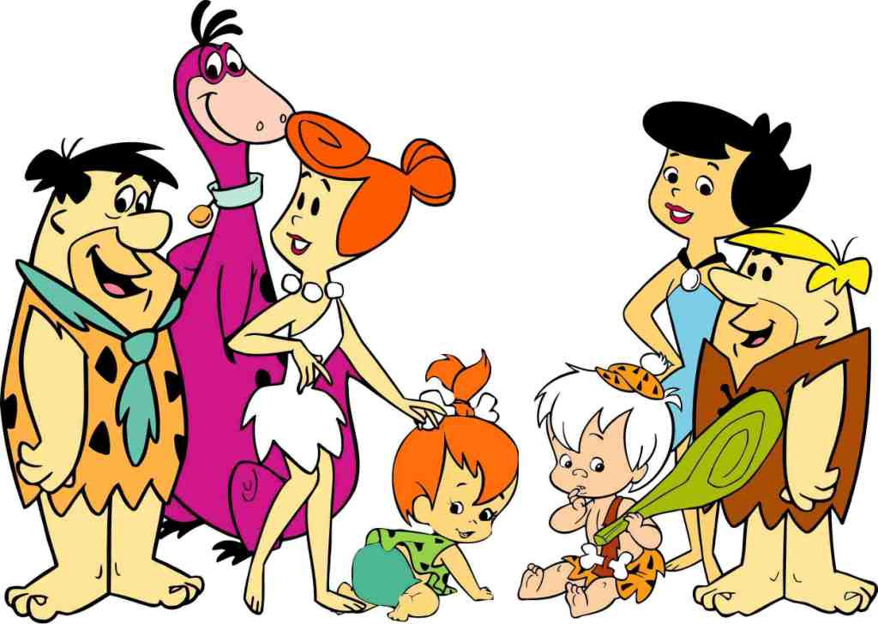
The Flintstones
The Flintstones lives in prehistoric town Bedrock. This is a happy family of three.
Fred Flintstone, Wilma Flintstone and their daughter Pebbles. The Flintstones has a pet called Dino. It’s very loyal and loving pet.
Betty and Barney Rubbles are their friends. They have a son called Bam-Bam. He is the world strongest kid! These families are very joyful, funny and happy.
Understanding
a) Who is the father?
b) Who is the mother?
c) Who is the daughter?
d) What is the pet name?
e) Who is visiting the Flintstones?
f) What is the little boy’s name?
g) Is Dino a dog?
h) Is Pebble a boy?
Correct the sentences below:
a) Fred Flintstone is the mother.
b) Wilma Flintstone is the daughter.
c) Bam-Bam is the pet.
d) Fred and Barney aren’t friends.
e) The Flintstones is a sad family.

