Slide 1
Mother
Подготовила: учитель английского языка
Бикмурзина Л.А.

Slide 2
Good-looking - Красивая
Tall - Высокая
Slim - Стройная
To look much younger – выглядеть моложе
Nice person – Хороший человек
Kind – Добрая
Creative - Творческий
Loving - Любящая
To cook – Готовить
To keep the house – Вести хозяйство
To take care - Заботиться
Practical - Практичная
Wash the dishes – Мыть посуду

Slide 3
My mother’s name is Mary. My mother is a teacher. She works at school. She likes her profession. She is a good-looking woman with brown hair. She is tall and slim. She is 44, but she looks much younger. She is a very nice person. She has a lot of friends. She is kind, creative, loving and always ready to help. My mother cooks very well.
My mother keeps the house and takes care of all of us. She is very practical. My father and I try to help her with the housework. I wash the dishes, go shopping and tidy up our flat.

Slide 4
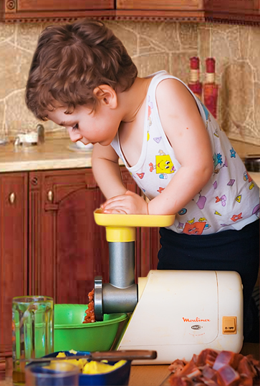
Dou you help your mother?
How do you help your mother?

Slide 5
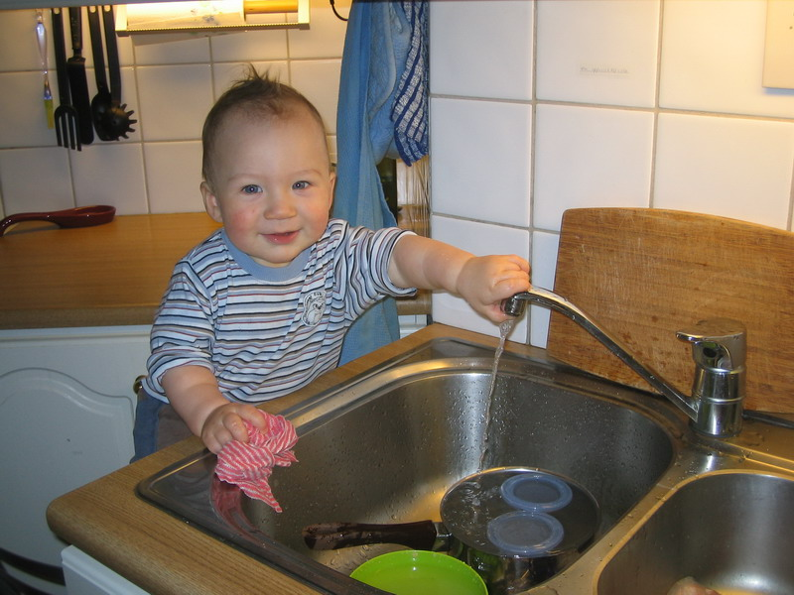
Help your mother set the table
with a knife and fork and spoon.
Help your mother set the table
every afternoon.
Help your mother clear the table
Take the knife and spoon.
Help your mother clear the table
Morning, night and noon.

