Slide 1
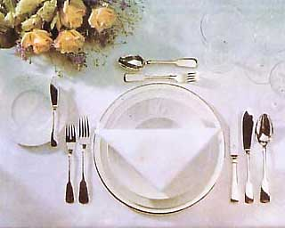
Serving a table

Slide 2
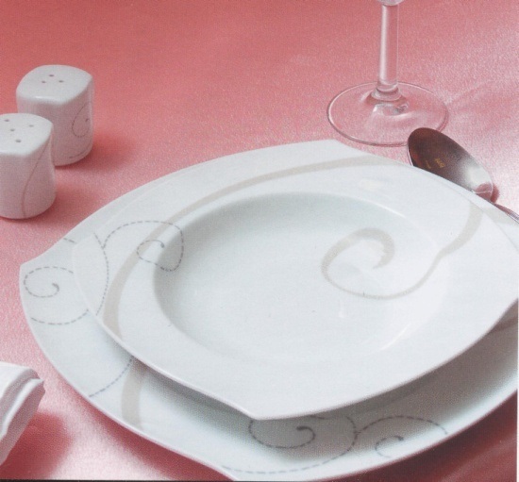
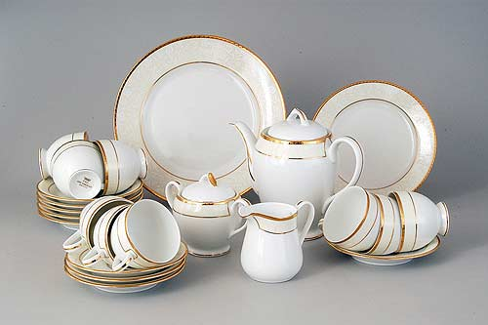
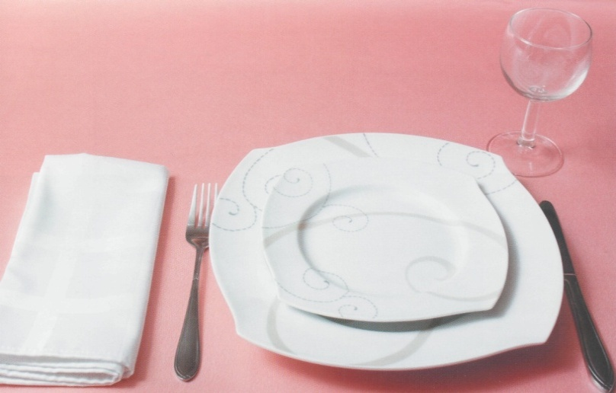
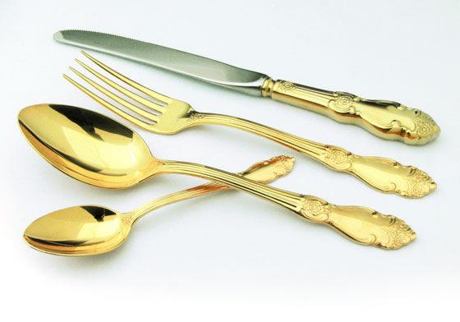
Dinner - service
A plate for the first course
A plate for the second course
A tea set
Cutlery

Slide 3
how to set A table

Slide 4
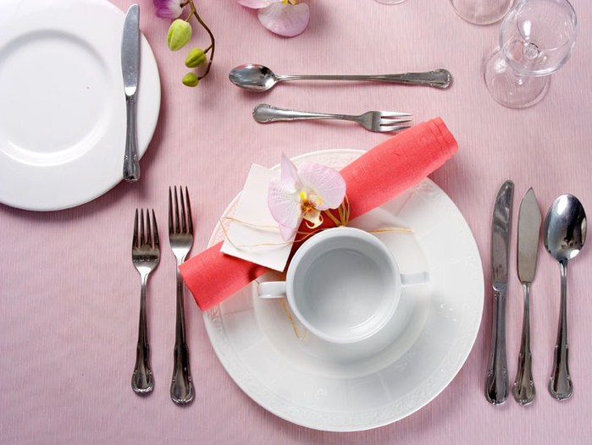
Prepositions of place
- to the right of - - - справа от
- to the left of - - - - слева от
- in front of - - - - - перед
- next to - - - - - - - рядом с
- оn - - - - - - - - - - на

Slide 5
Make up sentences using the words
1. put/ you/ should/ a meat knife/ to the right of/ the plate.
2. where/ I/ put/ should/ a fish fork?
3. a soup spoon/ to the left of the/ is/ the plate?
4. a spoon for dessert/ the plate/ should/ you/ put/ in front of.

Slide 6
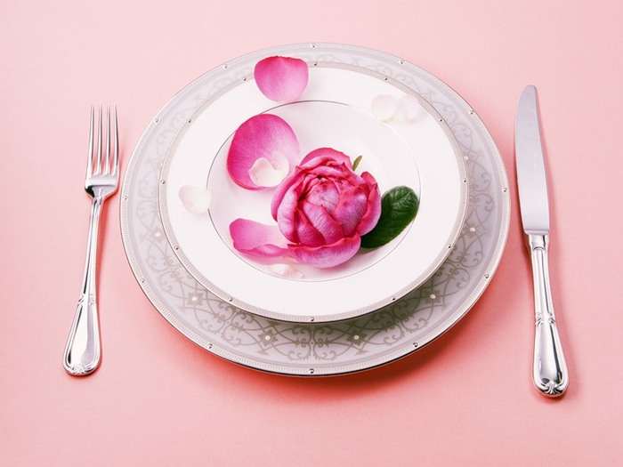
Check the sentences
1.You should put a meat knife to the right of the plate.
2. Where should I put a fish fork?
3. Is a soup spoon to the left of the the plate?
4. You should put a spoon for dessert in front of the plate .

Slide 7
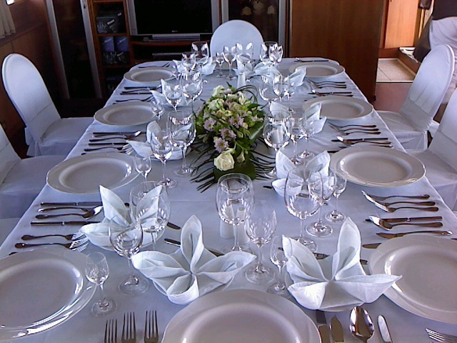
Thank you for your work

