Slide 1
ST. VALENTINE’S DAY
Автор презентации: Аверинова Ольга Алексеевна учитель английского языка ГБОУ СОШ № 497, г. Санкт-Петербург

Slide 2
Цель урока
Развитие положительной мотивации учения, воспитание чувства уважения к традициям и культуре других народов, обучение познавательной деятельности с использованием иностранного языка .

Slide 3
Задачи урока:
Совершенствовать навыки устной речи.
Развивать речевую культуру учащихся, культуру общения.
Расширять с помощью английского языка представление учащихся об окружающем их мире, о языке как средстве взаимодействия с этим миром.

Slide 4
St. Valentine’s Days
In Europe, North America and Australia, February 14th is a famous as V-day. On that day, people send valentines, special cards with an affectionate message, to their husbands and wives, parents and children, relatives and neighbors. The word valentine may mean a special little present.

Slide 5
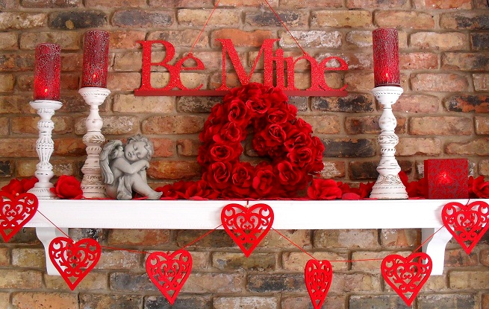
History
St. Valentine’s Day as a lovers festival dates at least from 14th century. However, St Valentine is rather a mysterious figure. In ancient Rome there were two martyrs of that name. one of them was a priest who perished in 269AD, the other was a bishop who perished in 273 AD. It is said that before the execution he sent a note of friendship to his jailers blind daughter and signed it “ Your Valentine”.

Slide 6
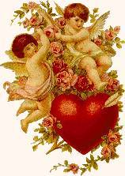
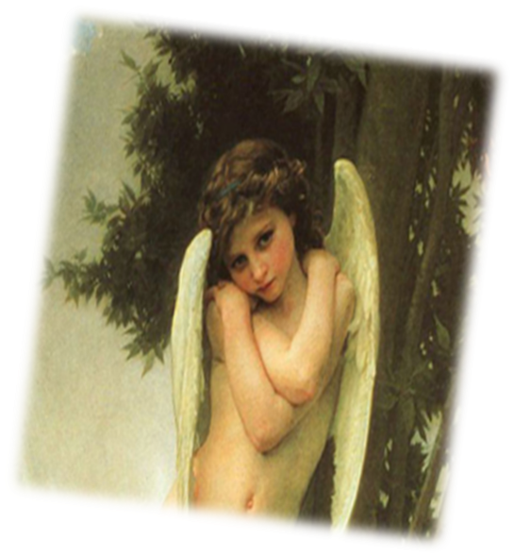
The customs
The custom of choosing a Valentine’s Day sweetheart may go back to the Lupercalia, a fertility festival of ancient Rome, which was held in the middle of February. Young Roman girls decorated love messages and put them in a large box. Unmarried young men drew the names from the box and in this way chose their partners for the festival.

Slide 7
There are a lot of traditions and superstitions connected with St. Valentine Day. Most of them have died out. Nowadays many girls still believe that the first boy seen on St Valentine’s Day will be their future husband.

Slide 8
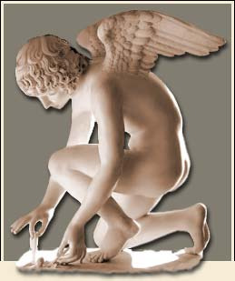
Celebration
Valentine’s Day is not a public holiday. Banks and offices do not close, but it is a happy holiday for little children and young people. It is also the day to have romantic dinner. Hearts, cupids, bows and arrows appear on dinner tables as well. Refreshments are often colored red, like candy and punch. Sandwiches and cakes are often cut in the shape of hearts. Sometimes a King and Queen of hearts chosen for the evening of the dance.

Slide 9
Valentine gifts
February 14th is the day to send little gifts to those you love. Flowers and sweets are favourite presents. Shops are filled with red, heart-shaped boxes of chocolate. Anonymous gifts of all kinds were laid upon the doorsteps of houses.

Slide 10
True or False?
St. Valentine’s Day is 14 February. (True)
This is the festival of flowers and spring. (False)
One of the earliest popular symbols of the day is Cupid. (True)
People of all ages love to send and receive telegrammes on St. Valentine’s Day. (False)
You can sign St. Valentine card “Your Secret Admirer”. (True)

