Slide 1
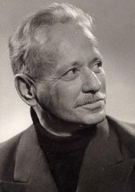
Mikhail Sholokhov

Slide 2
Biography
1905 - 1984 Mikhail Sholokhov Born May 11 (24 NS) on the farm Kruzhilinskiy Veshenskaia into a peasant family . He studied at the parochial school , then in high school , graduating four classes. The outbreak of revolution and civil war prevented further education . Sholokhov served Stanichno Revolutionary Committee , volunteered for the food unit.
In 1922 , at age seventeen , he went to Moscow , intending to learn. Met here with the poets and writers of the " Young Guard" . Assistance was available from , so I had to work as a loader and a bricklayer , and a bookkeeper and clerk .
In 1923 in the newspaper " Youth Truth" was published first feuilleton "test" signed " Sholokhov ." The following year saw the publication of his first story, " The Birthmark ."

Slide 3
Childhood and youth
Misha Sholokhov - the illegitimate son of a Ukrainian , wife of Don Cossack AD Kuznetsova and rich salesman (the son of a merchant , who comes with Ryazanschine ) A. Sholokhov . In early childhood, bore the surname Kuznetsov got a piece of land as a "son of a Cossack ." In 1913 , after the adoption of his own father , lost Cossack privileges , becoming a "son of a wimp ." Mike grew up in an atmosphere of apparent ambiguity that apparently spawned in nature Sholokhov craving for truth and justice , but at the same time and habit to hide yourself as much as possible about everything. About youth
Sholokhov with his life spreading the numerous legends which no documents confirming that contradict historical facts and elementary logic , but the writer has never denied them . He graduated from high school four classes . During the Civil War, the family Sholokhov could be under attack from two sides: for white Cossacks it was " out of town " dMisha Sholokhov - the illegitimate son of a Ukrainian , wife of Don Cossack AD Kuznetsova and rich salesman (the son of a merchant , who comes with Ryazanschine ) A . Sholokhov . In early childhood, bore the surname Kuznetsov got a piece of land as a "son of a Cossack ." In 1913 , after the adoption of his own father , lost Cossack privileges , becoming a "son of a wimp ." Mike grew up in an atmosphere of apparent ambiguity that apparently spawned in nature Sholokhov craving for truth and justice , but at the same time and habit to hide yourself as much as possible about everything. About youth Sholokhov with his life spreading the numerous legends which no documents confirming that contradict historical facts and elementary logic , but the writer has never denied them . He graduated from high school four classes . During the Civil War, the family Sholokhov could be under attack from two sides: for white Cossacks it was " out of town " for the red - " exploiters ." Junior Misha Sholokhov had no passion for hoarding ( like his hero , son of a wealthy Cossack Makar feeding ) and took the side of the victorious powers , install at least relative peace , served in the requisition , but arbitrarily reduced the incidence of men of his circle, was on trial .
A red - " exploiters ." Junior Misha Sholokhov had no passion for hoarding ( like his hero , son of a wealthy Cossack Makar feeding ) and took the side of the victorious powers , install at least relative peace , served in the requisition , but arbitrarily reduced the incidence of men of his circle, was on trial .

Slide 4
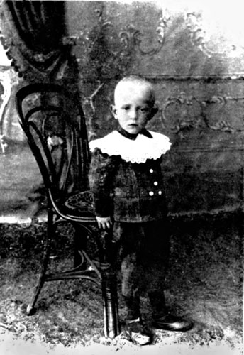

Slide 5
In 1920-1921, he lived with his family in the village Karghinskaya . After graduating from Rostov tax rate was appointed inspector of the food in the village Bukanovskaya , then joined the requisition , participated in the surplus-appropriation system . In 1920, the requisition led with 15 years (17.5 years ) Sholokhov was captured by Makhno . Then he thought he would be shot , but he was released. He later told about this meeting with Makhno differently , exposing himself as a hero . Under the shooting he was later, after the case of a stallion , which he received as a bribe from a fist when removing grain. Bribes were before, but then they told him , and he threatened the tribunal. In his autobiography, written April 5, 1949 for Vyoshenskaya military enlistment office , contains the following lines : " In 1922 he was sentenced , being prodkomissarom , for abuse of authority : one year of probation " (however, the time of the documents shows that Sholokhov never was the Commissioner nor food ( prodkomissar ) nor any other above the Village tax inspector , he did not get up . )

Slide 6
In September 1923 , signed " Micah . Sholokh "in Komsomol newspaper" Youth Pravda " ( " Young leniniets ") (now - " Moskovsky Komsomolets " ) was printed skit - " Test " , a month later there was a second skit - " Three ", and then a third - " Inspector " . In December 1923 Mikhail Sholokhov returned to Karginskaya , and then - to the village Bukanovskaya where woo Lydia Gromoslavskij - one of the daughters of the Village former Ataman Peter Yakovlevich Gromoslavskij . But the former chieftain said : "Take Mary, and I 'll make you human ." January 11, 1924 Mikhail Sholokhov married the eldest daughter - Maria Petrovna Gromoslavskij ( 1901-1992 ) , who worked as an elementary school teacher ( 1918 MP Gromoslavskij , studied in Ust- Medveditskaia school, whose director at that time Kryukov was FD ) .
The first story "Animals" (later " Prodkomissar ") posted MA Sholokhov 's Almanac " Molodogvardeets " was not accepted by the editors. December 14, 1924 in the newspaper " Young Leninist " came the short story " The Birthmark ", opens the cycle Don stories : "The Shepherd ", " Ilyukha ", " foal ", " azure steppe ", "Family Man," " mortal enemy ", " Dvumuzhnyaya "etc. They were published in the periodical of the Komsomol , and then made ​​three collections , coming one after the other :" tales of the Don "," azure steppe "(both - 1926) and" On Kolchak , nettles and other things "(1927 ) .

Slide 7
Mikhail Sholokhov died February 21, 1984 of throat cancer at age 78 . A lot or a little? Can we say that Sholokhov , like any other person , in this age , " has lived his own, it's time to know and honor ?" Hardly. Non-smokers in this age group are almost always in good health, do not suffer from dementia or marasmus , and often still have quite a decent force in the body. And when you consider that the Cossacks as the Don , and many others, have always lived a relatively long time , then 78 years for them - age, although respectable , but not so elderly . In the end, is not it better to die peacefully and without pain , suddenly than many months , and sometimes years , and dying from cancer , corroding inside the body and converting it into a bloody pulp ?

Slide 8
