Slide 1
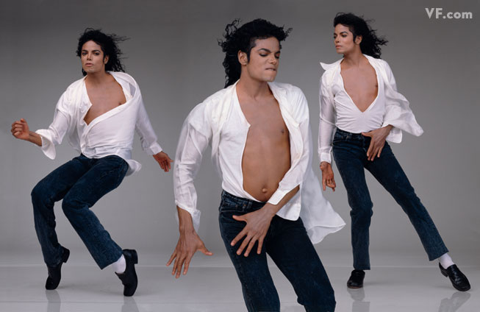
“I’m totally at home on the stage. That’s where I live. That’s where I was born. That’s where I’m safe.” M.J.

Slide 2
The Lessons of Michael Jackson.
Today the topic is The Lessons of Michael Jackson. Let’s look at the board and read our tasks.
“This Is It” - Movie Premiere.
Lessons You Must Learn From Michael Jackson’s Movie “This Is It”.
Last Rehearsal.
Lessons You Must Learn From Michael Jackson’s Songs.
Test: How well do you know M.J.?
Interview with dancer Timor Steffens/ AP Interview: Obama Reflects on Michael Jackson.
Homework.

Slide 3
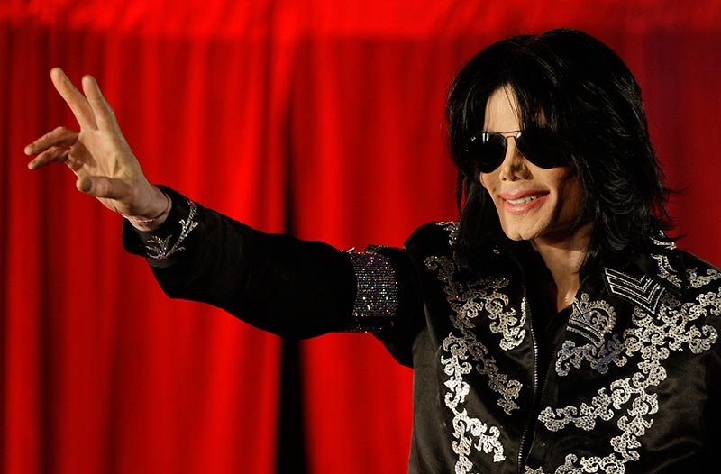
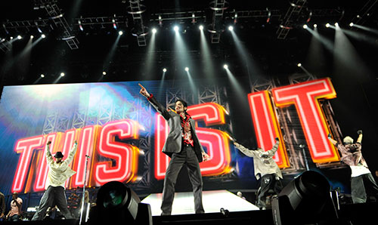
Now let’s watch and listen. What did M.J. say during his last official statement?
How do you find the film?
Let’s try to speak about him and describe him.
What do you feel about the film?
Is it a great film?

Slide 4
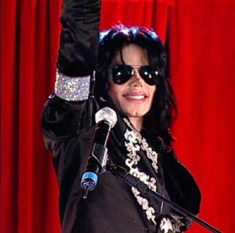
What did M.J. say during his last official statement?
"Thank you all. This is it. I just want to say these will be my final shows, performances in London. This will be it."When I say this is it, I really mean this is it." "I'll be performing the songs my fans want to hear. This is the final curtain call, OK, and I'll see you in July." "I love you. I really do. You have to know that”. "I love you so much, really, from the bottom of my heart."
Who is the executive director of this film?

Slide 5
Lessons You Must Learn From Michael Jackson’s Movie “This Is It”
Practice, Practice, Practice and then Practice Perfect.
Know Your Work Better Than Anyone Else.
Have a Strong Personal Coach.
“The greatest education in the world is watching the masters at work.” M.J.
Work only With the Best.

Slide 6
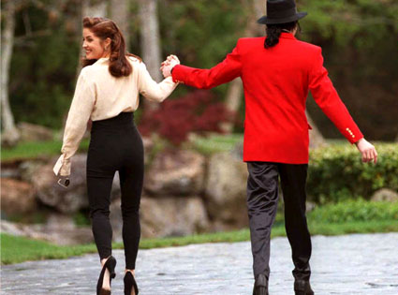
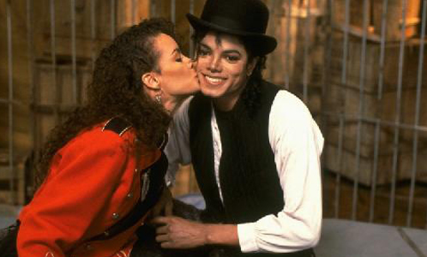
Let's remember Michael Jackson doing what he did best. What's your favorite Michael Jackson’s song? Let's remember the music. Last Rehearsal.
Listen to the messages and the lessons you can get from his music:
Lesson of Love
Lyrics: Oh I`ll be workin` from nine to five To buy you things to keep you by my side I never felt so in love before Just promise baby, You`ll love me forevermore

Slide 7
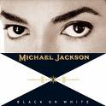
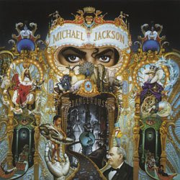
The Lesson of Sameness:
See, it's not about races Just places Faces Where your blood Comes from Is where your space is I've seen the bright
DON'T EXPECT OTHERS TO UNDERSTAND YOU.
You got school teachers Who don't wanna teach You got grown people Who can't write or read You got strange diseases Ha! But there's no cure You got many doctors That aren't so sure So tell me
………… Stop tripping

Slide 8
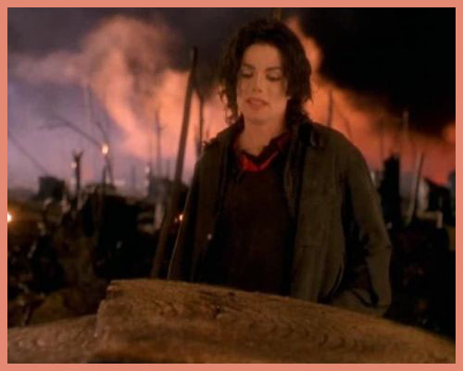
Be careful of who you love
People always told me be careful of what you do And don't go around breaking young girls' hearts And mother always told me be careful of who you love
Take Care of the World
What about sunrise What about rain What about all the things That you said we were to gain... What about killing fields
Don’t be afraid.
I'm gonna be Exactly what yo came to see It's you who's taunting me Because you're wanting me
To be the stranger in the night

Slide 9
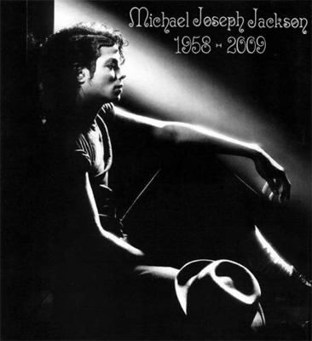
To Your Ownself Be True
If you wanna make the world a better place Take a look at yourself and then make a change, yey
Parting Is Hard
Shiny and sparkly And splendidly bright Here one day Gone one night
Like the loss of sunlight On a cloudy afternoon ………………….

Slide 10
How Well Do you know Michael Jackson?
When was Michael Jackson Born?
September 3rd 1965 October 9th 1975 August 29th 1958 October 28th 1964 What is Michael Jackson's middle name?
Joseph Prince Jermaine When did Michael Jackson die? (RIP KING)
I don’t know October 17th 2009 June 25th 2009 That day when everyone was sad.

Slide 11
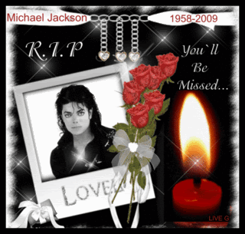
How Well Do you know Michael Jackson?
What DAY did Michael die on? ( True Fans will know!)
Thursday Saturday Friday Monday Finish the lyrics: This is it. Here I stand. I’m the light of the world....?
I’m the Man. I feel Grand. I am Grand. What is the name of Michael Jackson's
youngest son?
Prince Michael Jackson the second Blanket He has kids?!?!?!? None of the above

Slide 12
What did Michael say he would do if all the children in the world died?
He would laugh He said he would end it all (Kill Himself) He would cry Make a song When did the "Michael Jackson's This is it" movie come out?
This year October 28th 2009 August 29th 2009 That’s a movie?!? Finish the lyrics: What about sunrise. What about rain...?
What about all the things that you said we were to gain? What about all the cars, the clothes, and the chains? What about another happy day? Never heard this before....

Slide 13
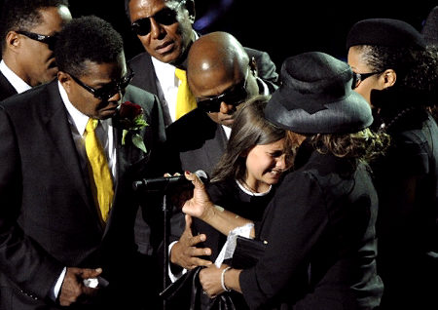
What doctor gave Michael Jackson drugs that killed him?
Dr. Conrad Murray Dr. Sanjay Colins Dr. Muary Povich Dr. Suess
What is Michael Jackson's
daughter’s name?
Michelle Jackson He doesn’t have a daughter Paris Jackson
“I just wanted to say, ever since I was born, Daddy has been the best father you could ever imagine. And I just wanted to say, I love him so much.”

Slide 14
HOMEWORK:
1. Search the Internet and find more information about Michael Jackson. Talk about what you discover with your partner(s) in the next lesson.
3. MAGAZINE ARTICLE: Write a magazine article about Michael Jackson. Include an interview with him. Write about what he does every day and what he thinks about. Read what you wrote to your classmates in the next lesson. Give each other feedback on your articles.

