Slide 1
Pavel Mikhailovich Tretyakov- (1832-1898) the Moscow merchant, the collector and the charity man.
Презентация для урока «Искусство»
Учитель английского языка
Комендантова Н.Г.

Slide 2
ts
His great-grandfather Elisey Martynovich Tretyakov came to Moscow from Maloyaroslavtsa in 1774. His grandfather the merchant Zahar Eliseevich created the plant of dyeing and starching canvas and linen in Moscow in 1828. His father was a shopkeeper and in 1846 he bought and rebuilt bath-houses for men and women.
Mihail Zaharovich Tretyakov married on Alexandra Danilovna Borisova. Her father was a commerciant sold lard to England. On the 27th of December Pavel Mikhailovich was born. He had four brothers and four sisters, but in 1848 four children died and in 1850 his father died too.
Pavel Mikhailovich got excellent home education. In 1850 he and his brother Sergei got father’s business. Pavel married only on Vera Nikolaevna Mamontova in 1865. They were happy. They had six children. Their younger son died and elder son was ill. But their four daughters got excellent home education.
The Tretyakovs travelled a lot. They liked nature, art and music. Pavel Mikhailovich was rich and he said money should serve people and nation. Because he bought a lot of paintings for his gallery, when he travelled. He got on with artists and helped them. He understood the movement “Peredvizhniki”.
Pavel Mikhailovich Tretyakov was a charity man, he helped sick children, poor artists, financed galleries and exhibitions, created orphanages for children, widows. He died in1898. He was buried on the Danilovskom cemetery. He was reburied on the Novodevichem cemetery in 1948.

Slide 3
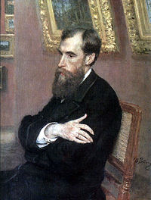
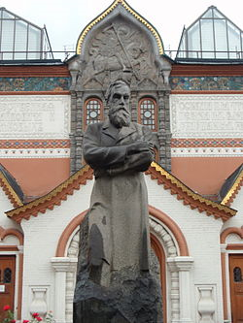
The State Tretyakov Gallery
The gallery’s history starts in 1856 when P.M.Tretyakov acquired works by Russian
famous artists of his day with the aim of r creating a collection, which might later
grow into a museum of national art. In 1892 T 1892, Tretyakov presented his already
famous collection of 2000 works
(1362 paintings, 526 drawings, 9
sculptures) to the Russian nation.

Slide 4
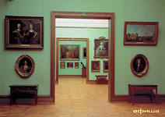
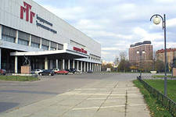
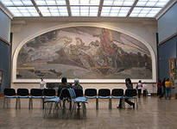
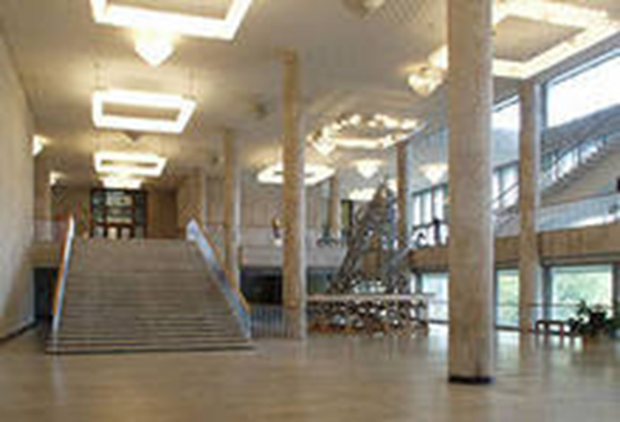
The facade of gallery building was designed by the painter Viktor Vasnetsov in a Russian fairy-tale style. It was built in 1902-1904 to the south from the Moscow Kremlin. During the 20th century, the gallery expanded to several neighboring buildings .
In 1985 the Tretyakov Gallery was administratively merged with a gallery of cotemporary art, housed in a large modern building along the Garden Ring, immediately south of the Crimean Bridge. In 1986 the main building of the Tretyakov Gallery was reconstructed,
saving the historical building. In 1989 the new building was built there was housed a conference-hall, an information center and others.
The collection contains more than 130000 exhibits.

Slide 5
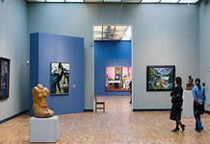
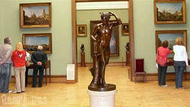
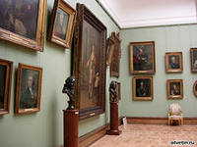
In the halls of the museum

Slide 6
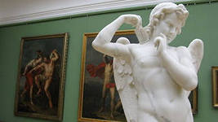

Slide 7
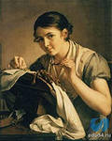

Slide 8
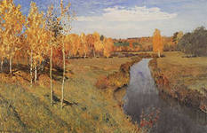
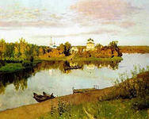
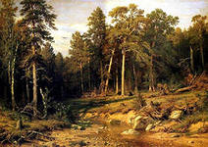

Slide 9
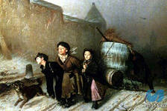
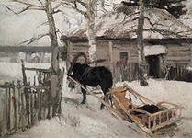
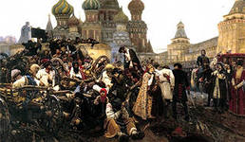

Slide 10
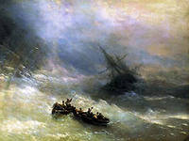
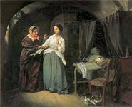
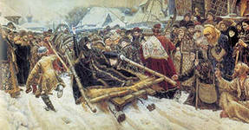

Slide 11
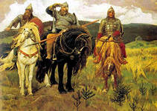
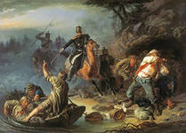

Slide 12
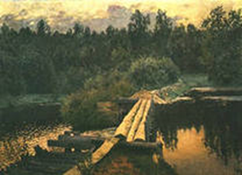
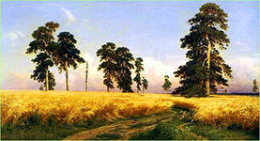

Slide 13
